Slide 1
Behavior of the North Anatolian fault (Turkey) deduced from InSAR and GPS studies
Ziyadin ÇAKIR
Istanbul Technical University
Department of Geology
Collaborators: A. Akoğlu, E. Çetin, S. Ergintav, M. Meghraoui, R. Reilinger

Slide 2
Outline
The North Anatolian Fault
Introduction
Interseismic strain accumulation
Surface creep

Slide 3
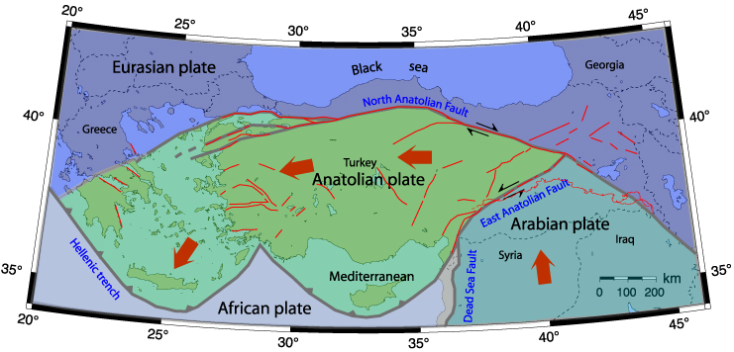
Tectonics of the Eastern Mediterranean Region

Slide 4
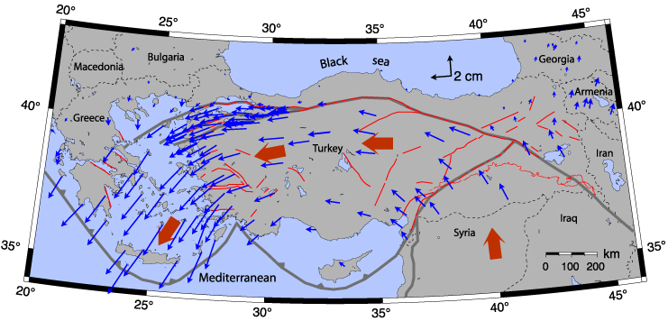
Tectonics of the Eastern Mediterranean Region
(McClusky et al., JGR, 2000)

Slide 5
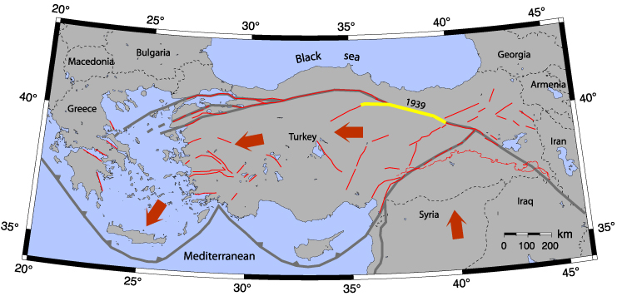
Westward earthquake migration

Slide 6
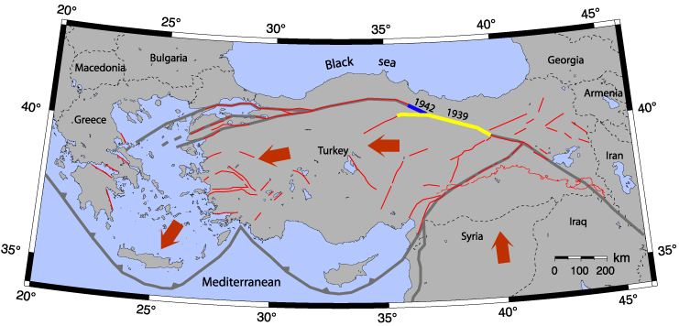
Westward earthquake migration

Slide 7
Westward earthquake migration

Slide 8
Westward earthquake migration

Slide 9
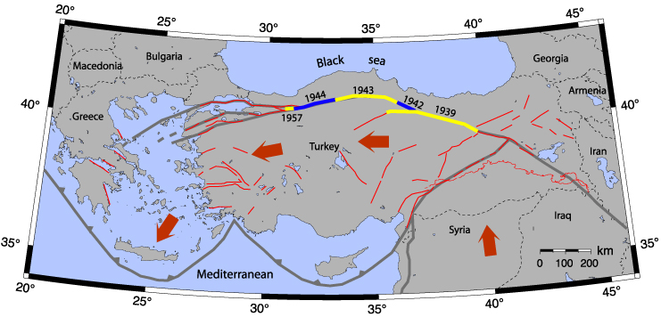
Westward earthquake migration

Slide 10
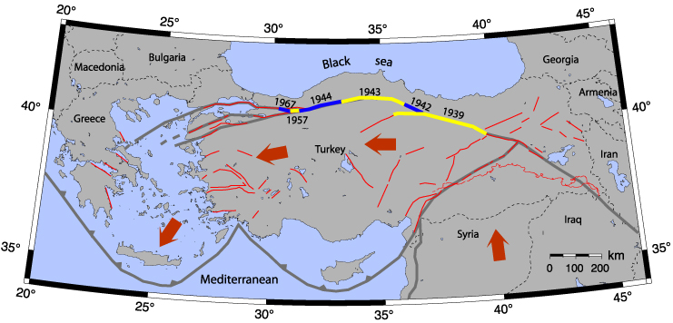
Westward earthquake migration

Slide 11
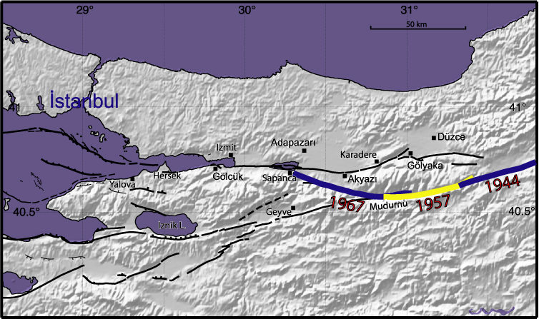
Westward earthquake migration

Slide 12
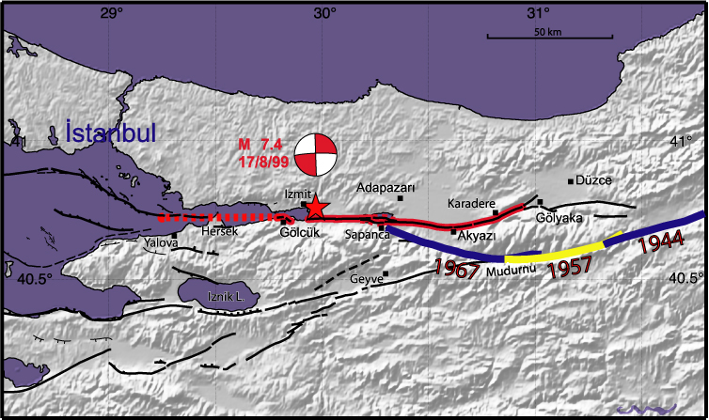
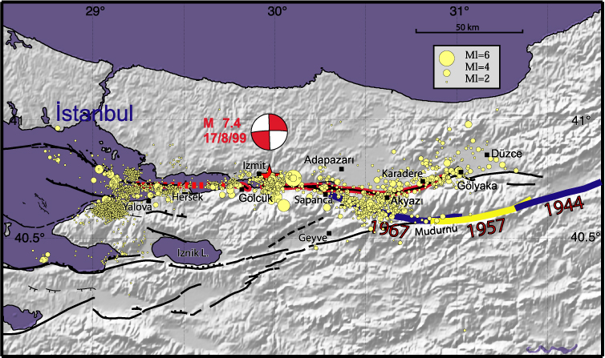
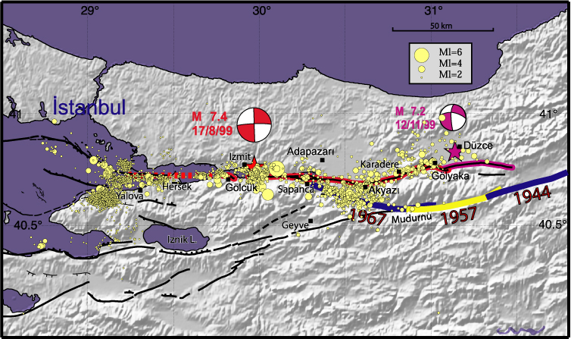
Westward earthquake migration
was this westward migration just a coincidence?

Slide 13
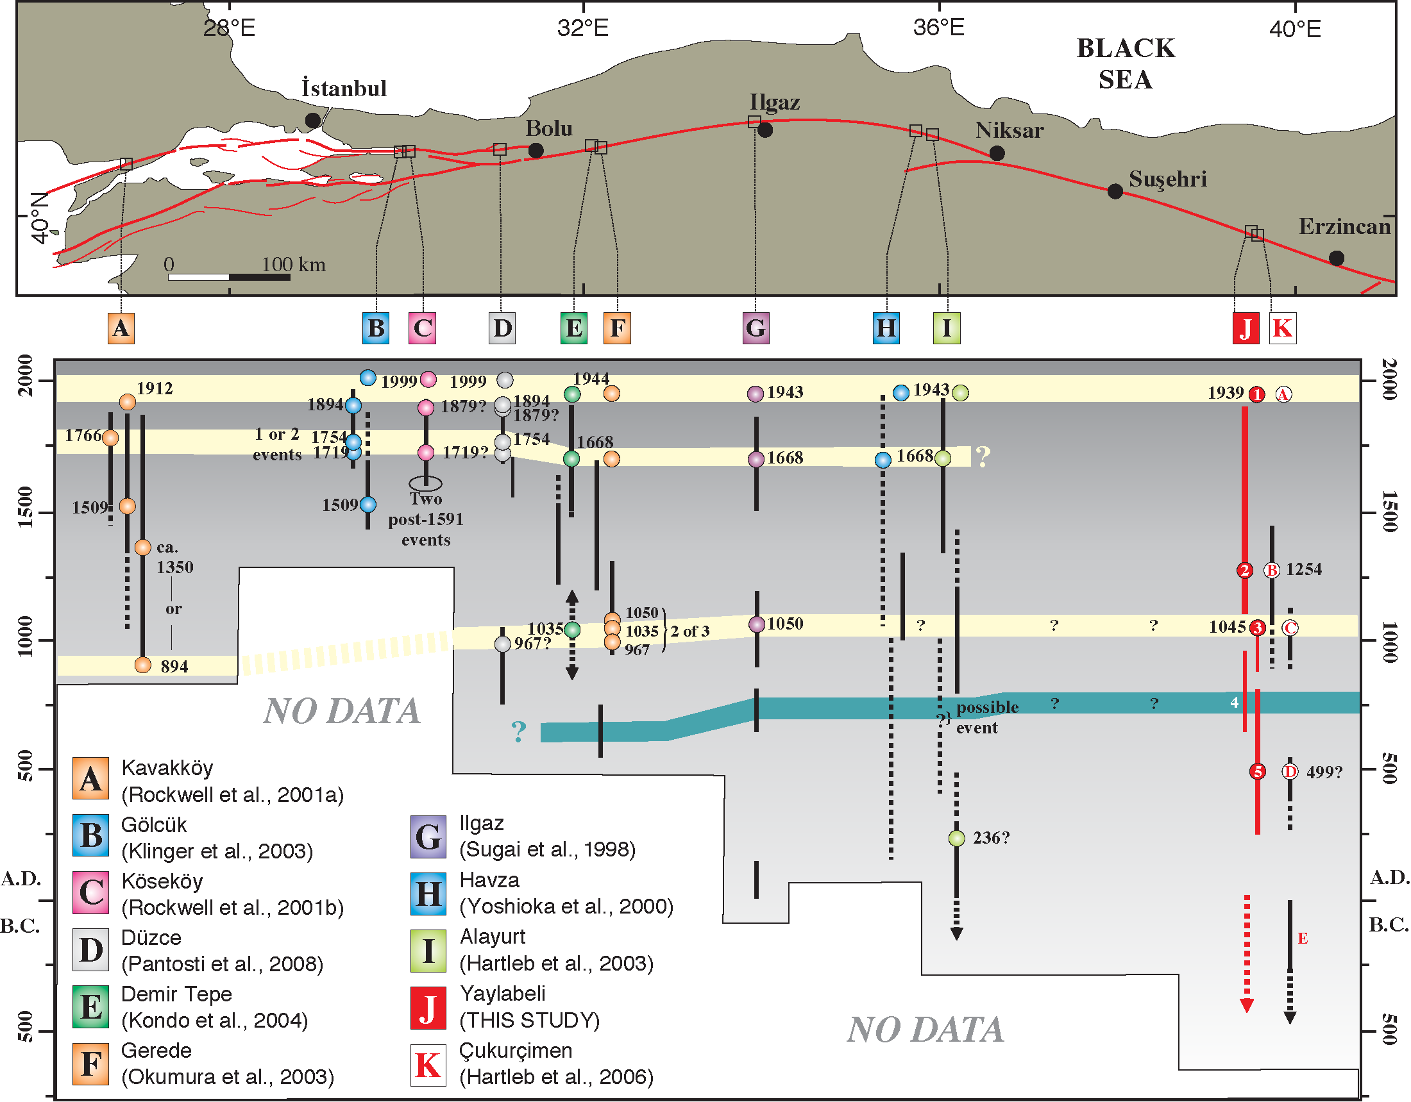
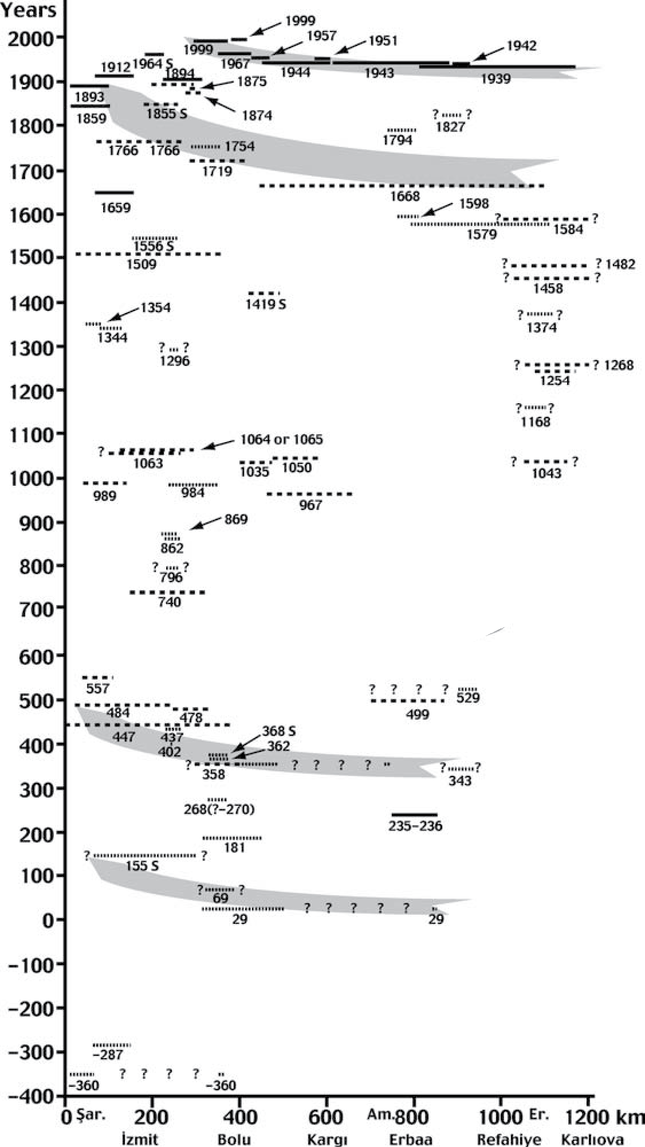
Previous westward earthquake migrations?
Kozaci et al., Lithosphere, 2011
Şengör et al., Annu. Rev. Earth Planet. Sci, 2005

Slide 14
Coulomb Stress Transfer
Stein et al., GJI, 1997

Slide 15
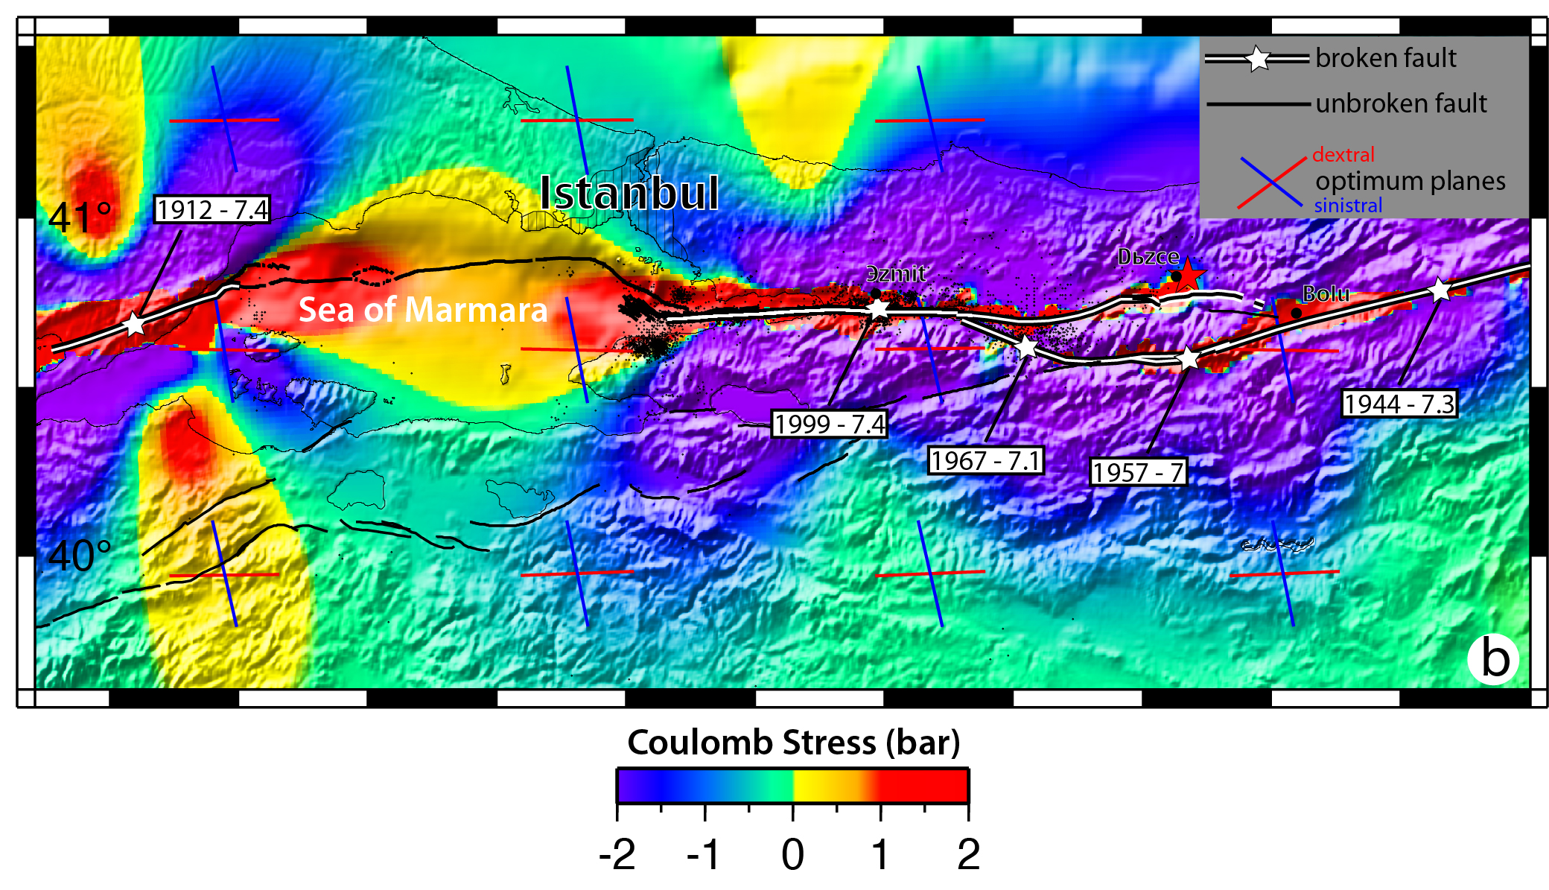
Waiting for the big one

Slide 16
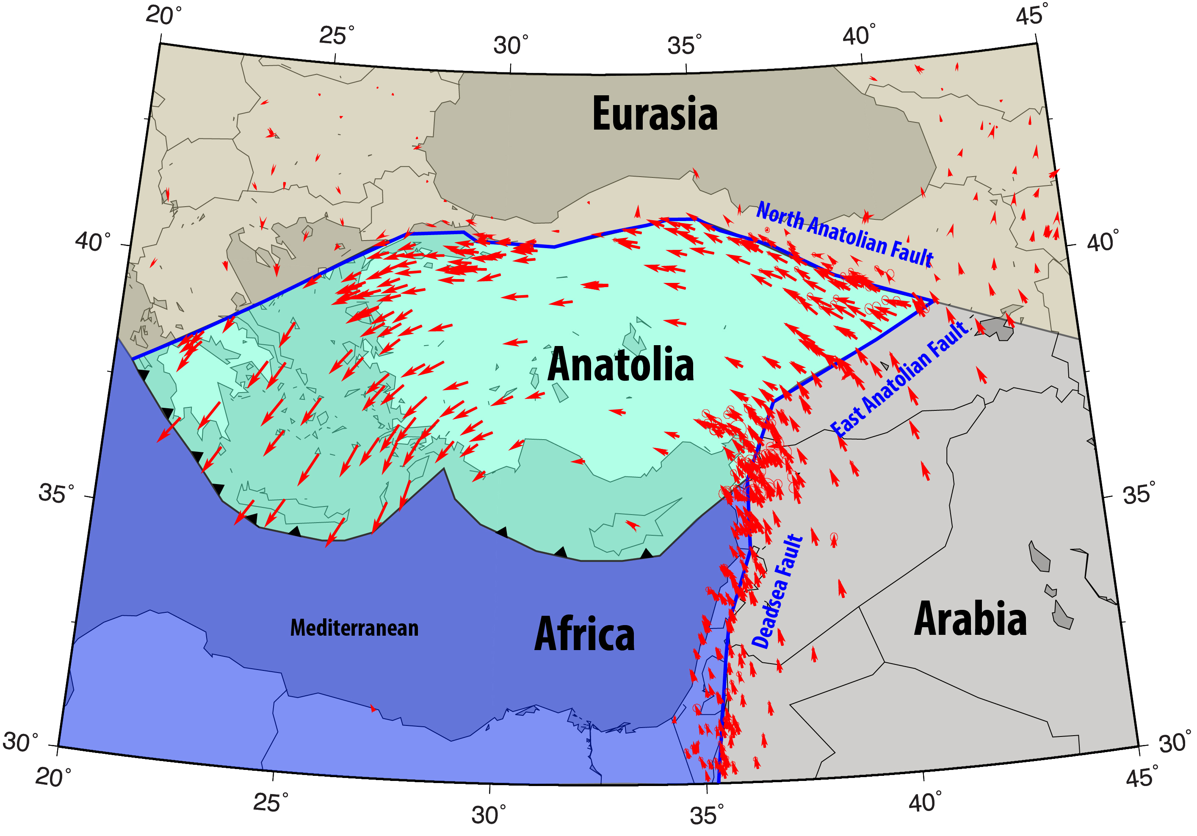
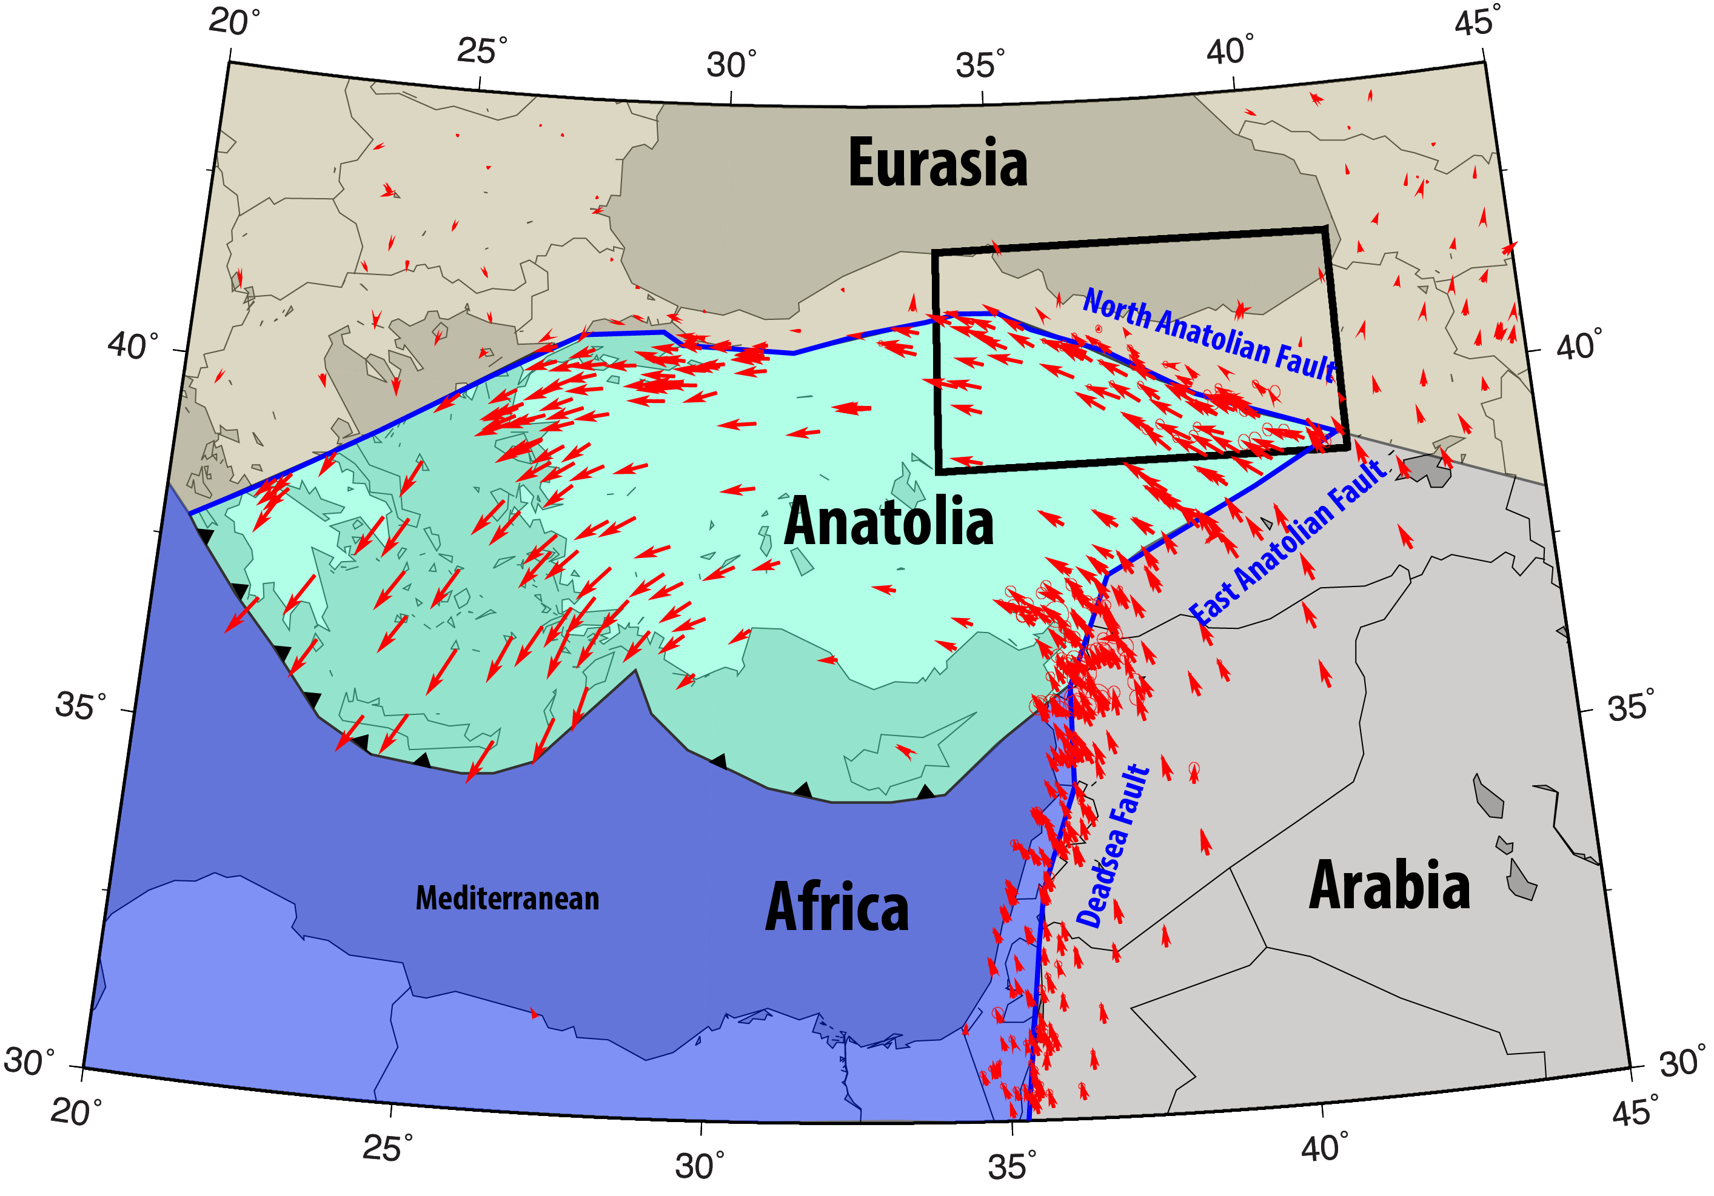
Interseismic strain accumulation along the NAF

Slide 17
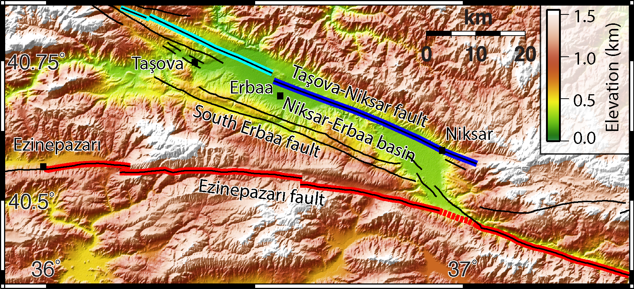
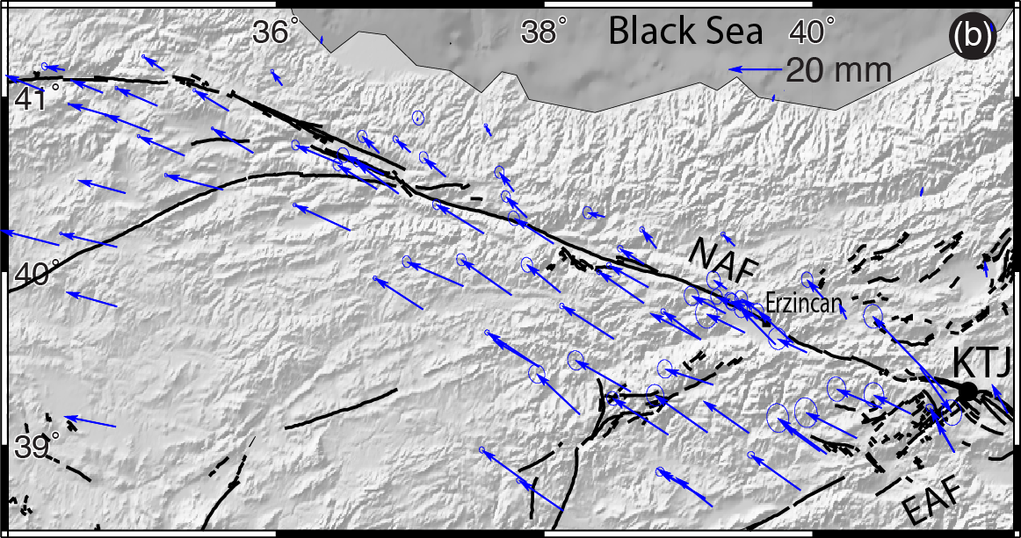
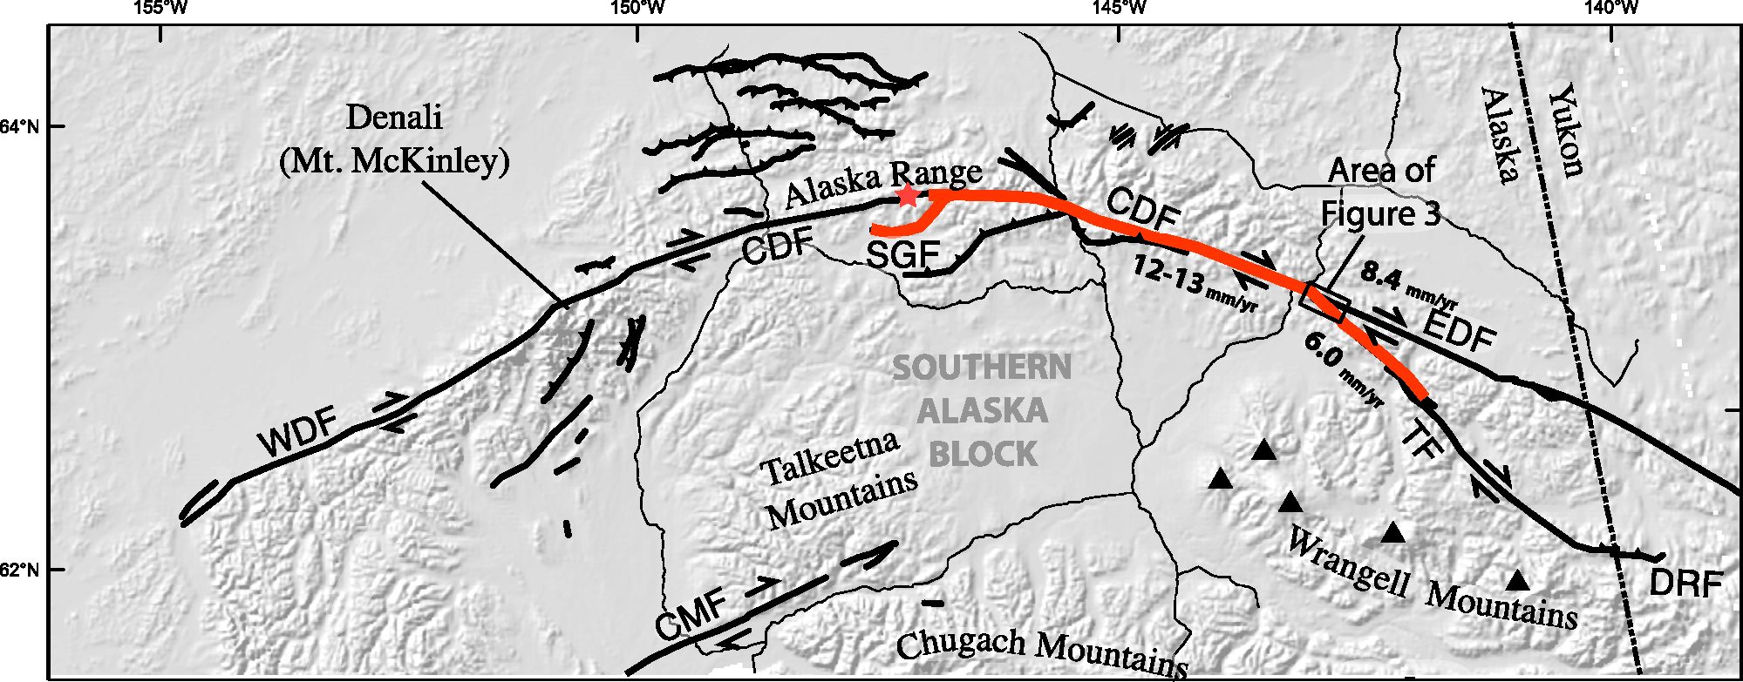
Rupture branching
Will the Ezinepazarı fault rupture together with the Erzincan-Niksar fault again?
Preexisting stress state, rupture velocity, branch angle
Structure of the fault zone: Fault connectivity
Earthquake history: the amount of accumulated slip
1943
Niksar – Erbaa
pull-apart
1942
1668
Ezinepazarı fault
1939
Erzincan-Niksar fault
Schwartz et al., JGR, 2012

Slide 18
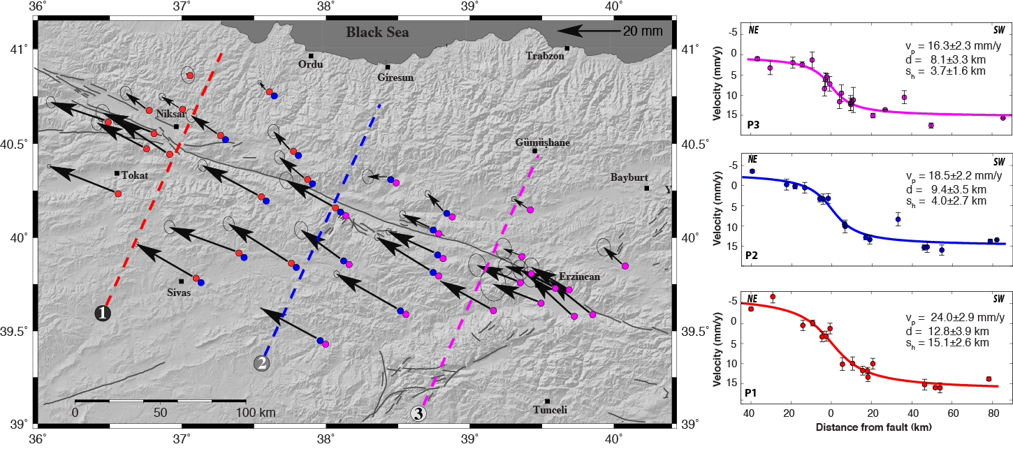
Interseismic strain accumulation
Tatar et al., J. Geodyn. 2012

Slide 19
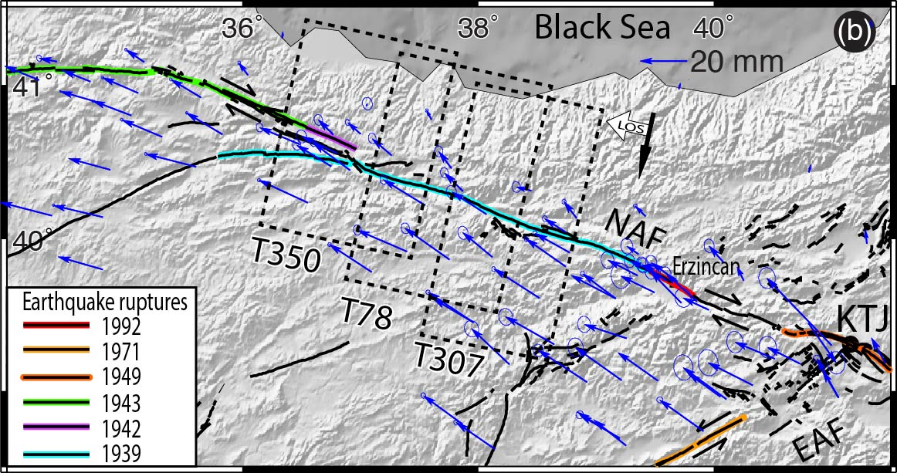
InSAR observations

Slide 20
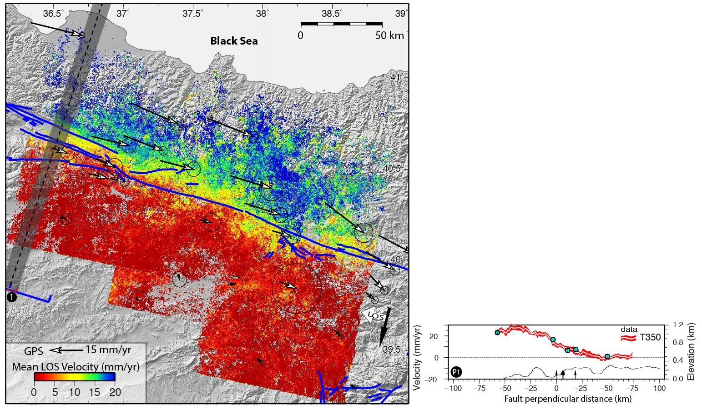
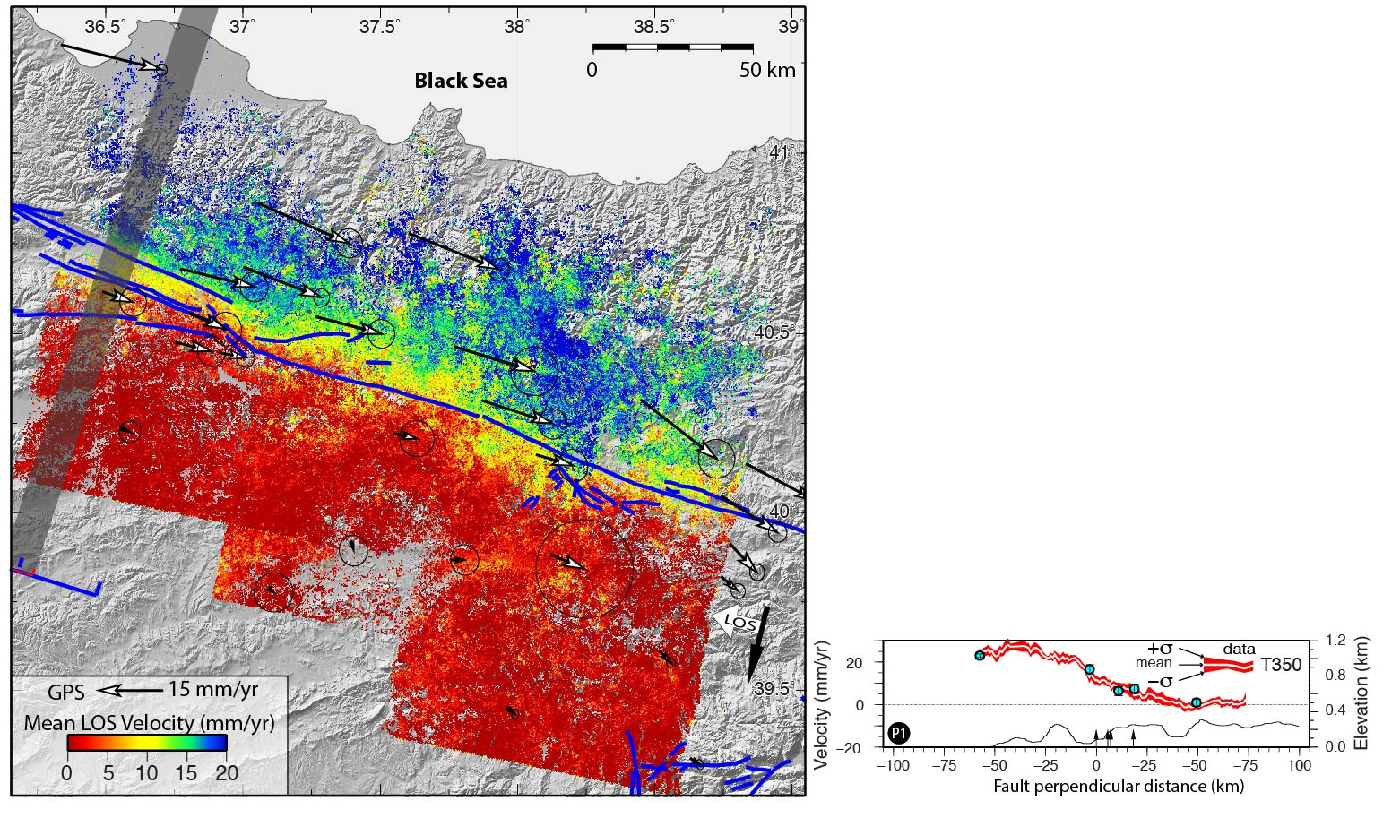
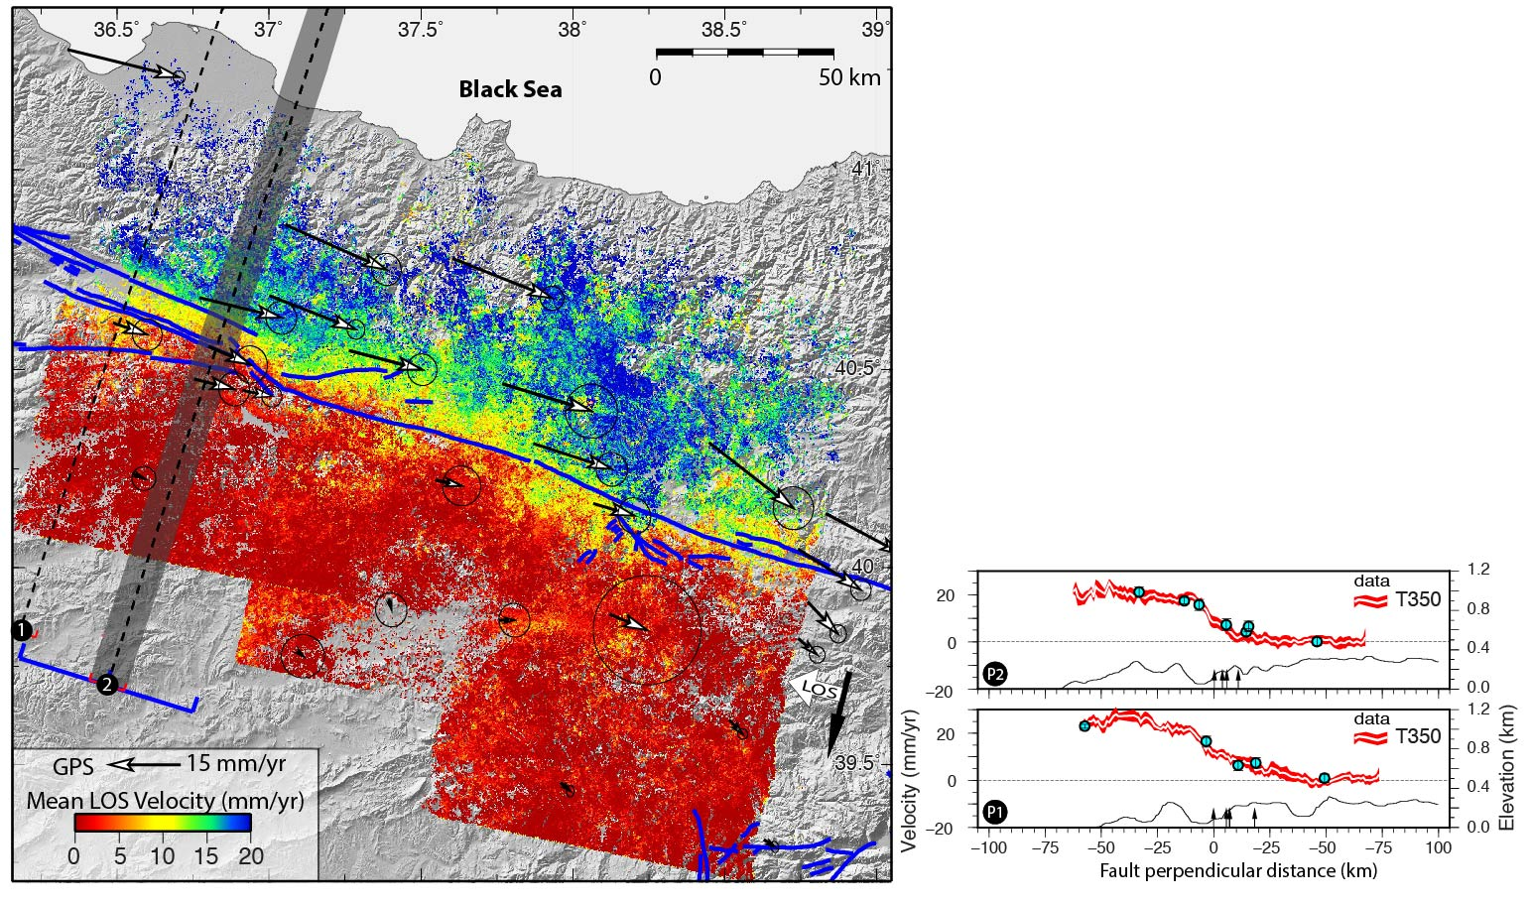
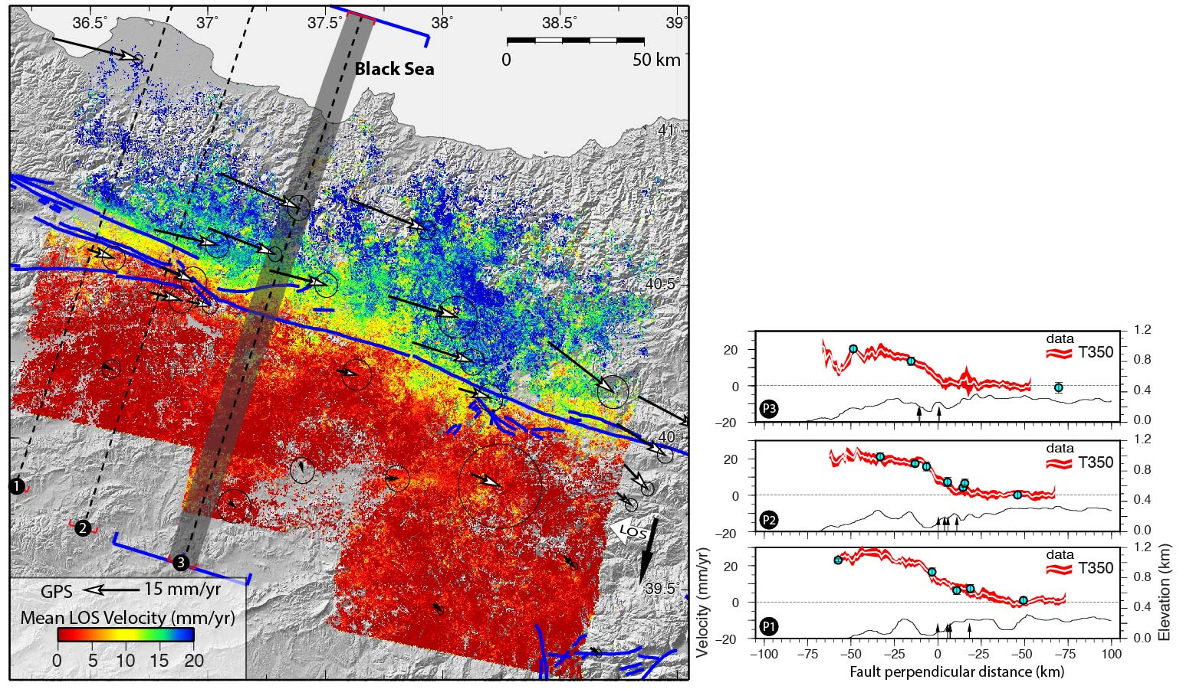
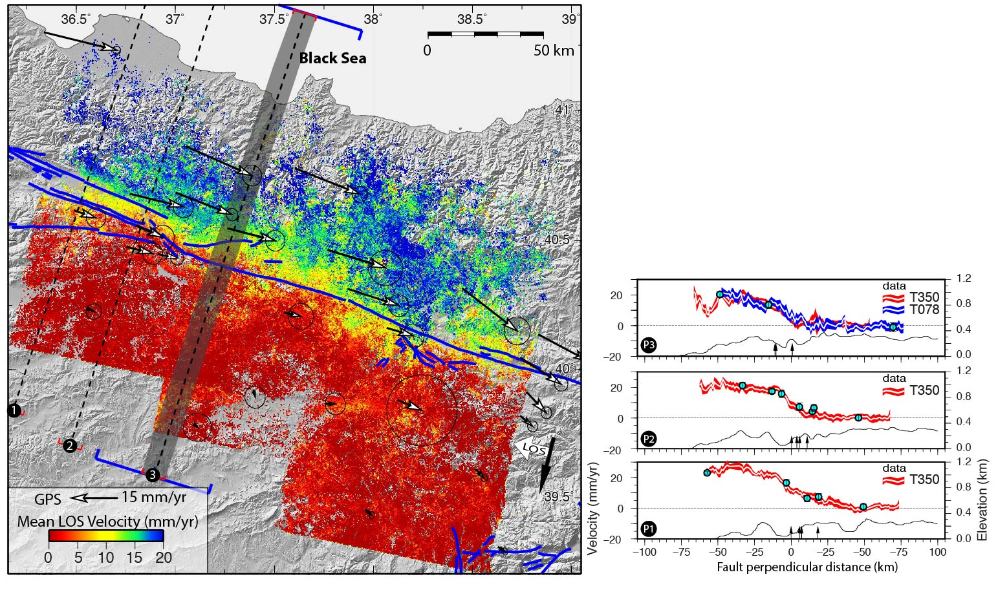
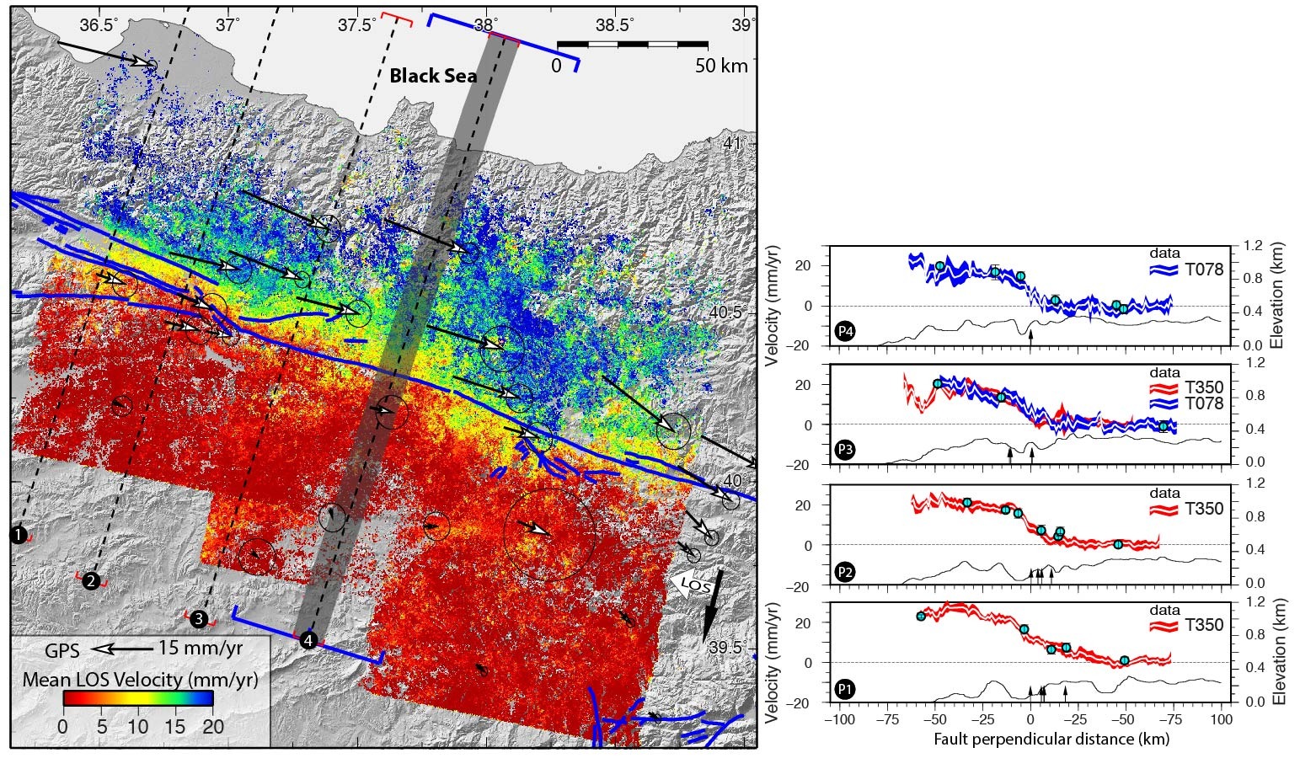
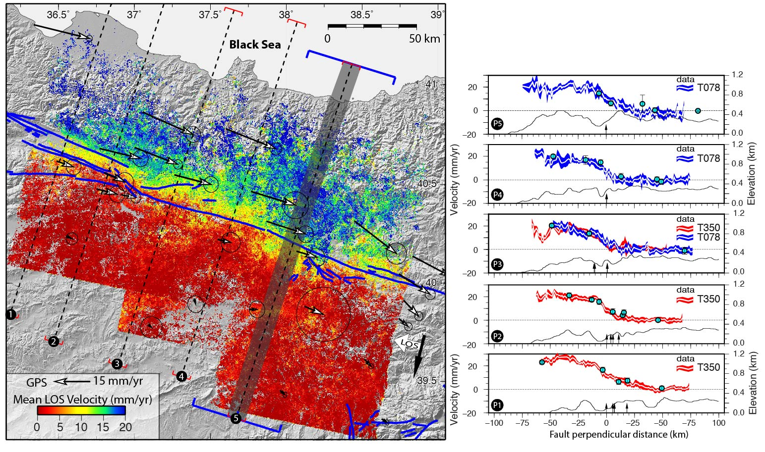
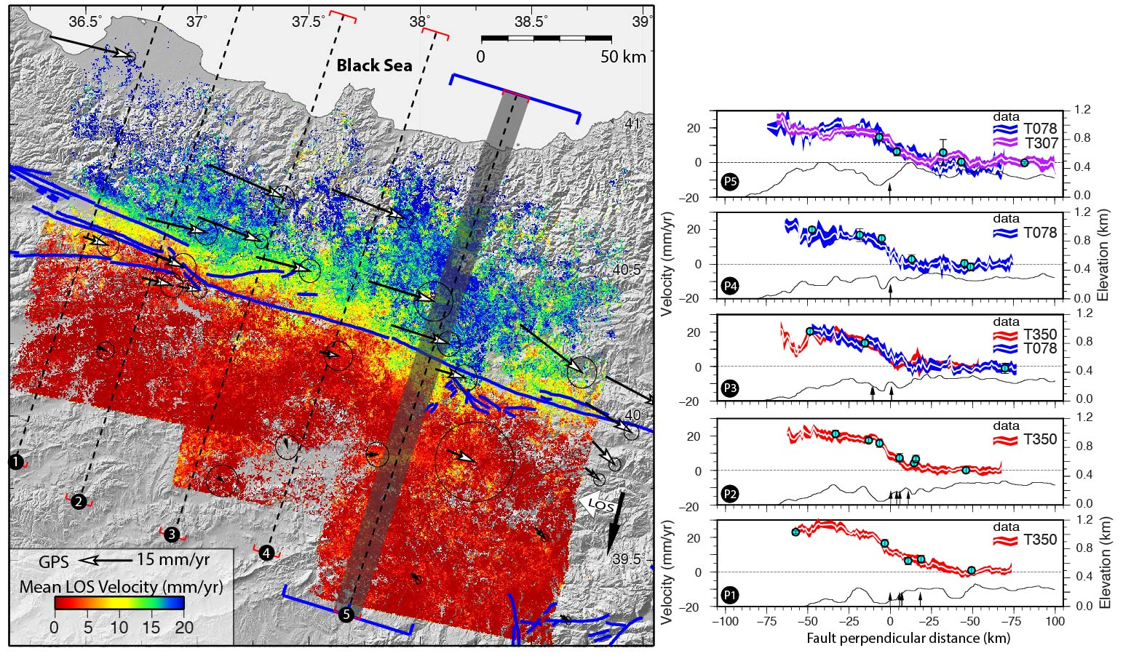
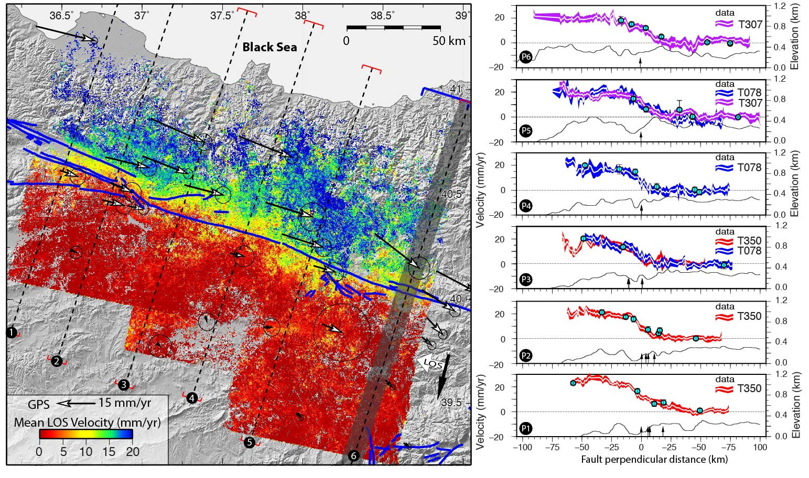
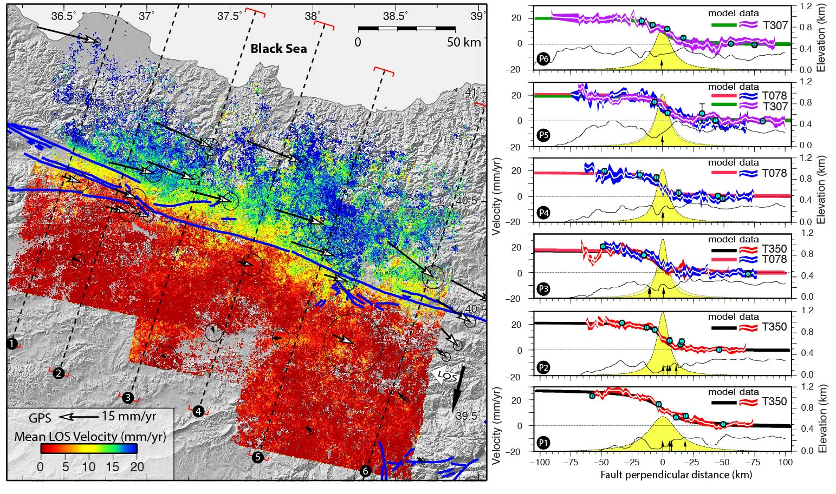
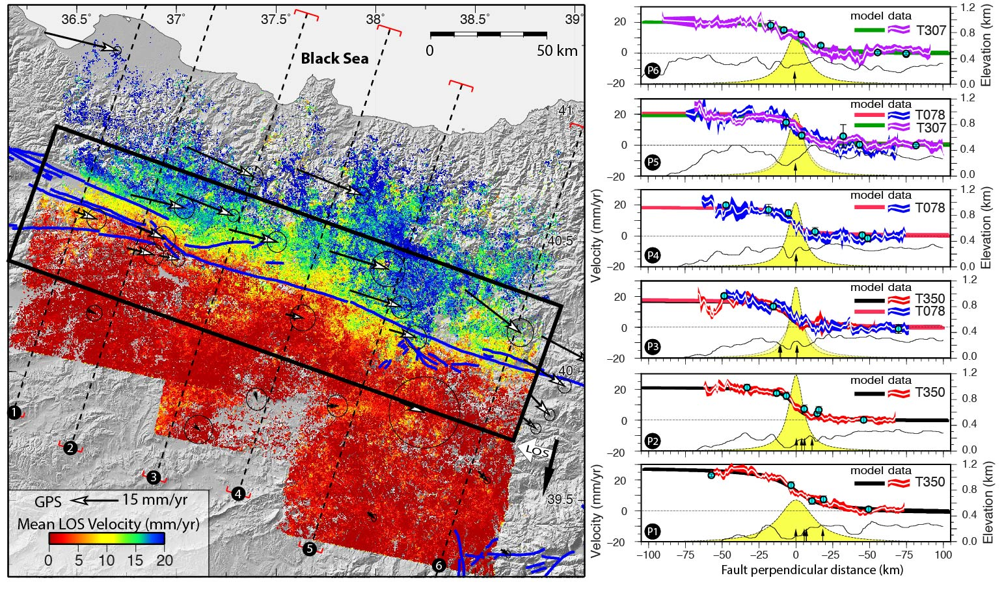
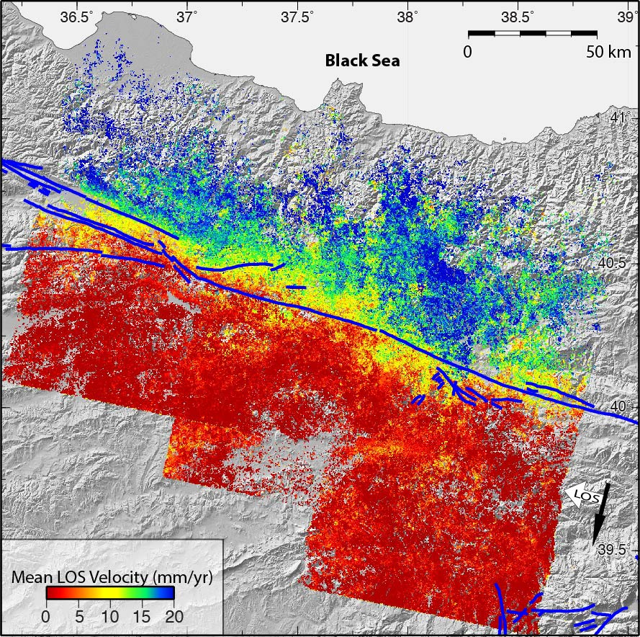
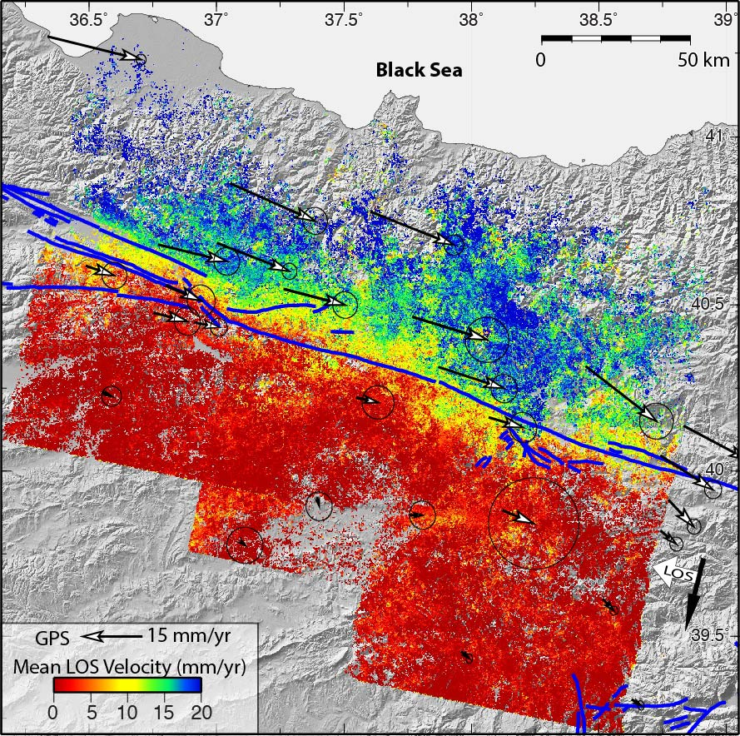
PS-InSAR velocity field
Mean Fault parallel velocity (mm/yr)
Mean Fault parallel velocity (mm/yr)
Mean Fault parallel velocity (mm/yr)
Çakir et al., JGR, 2014

Slide 21
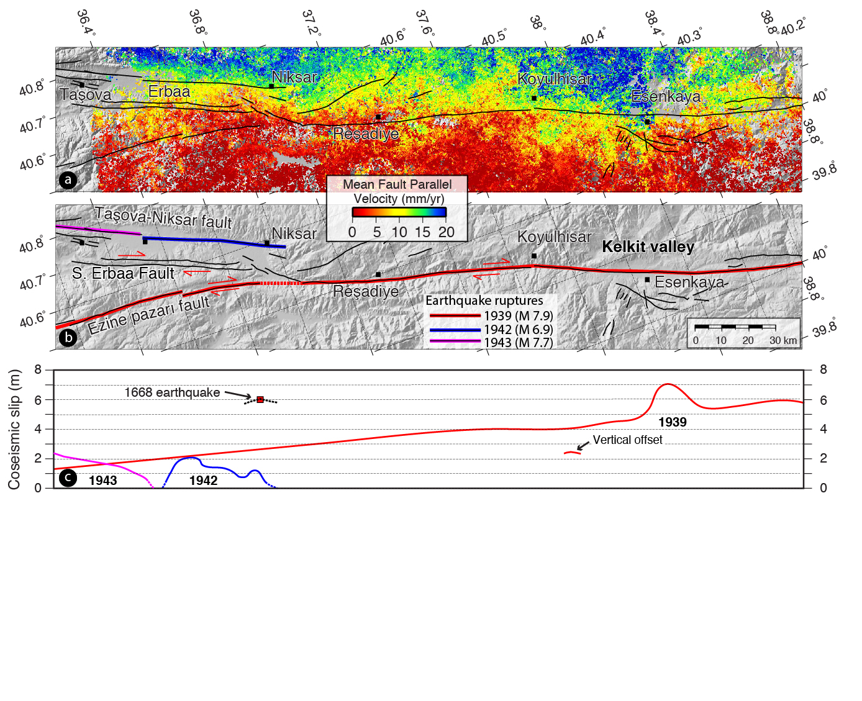
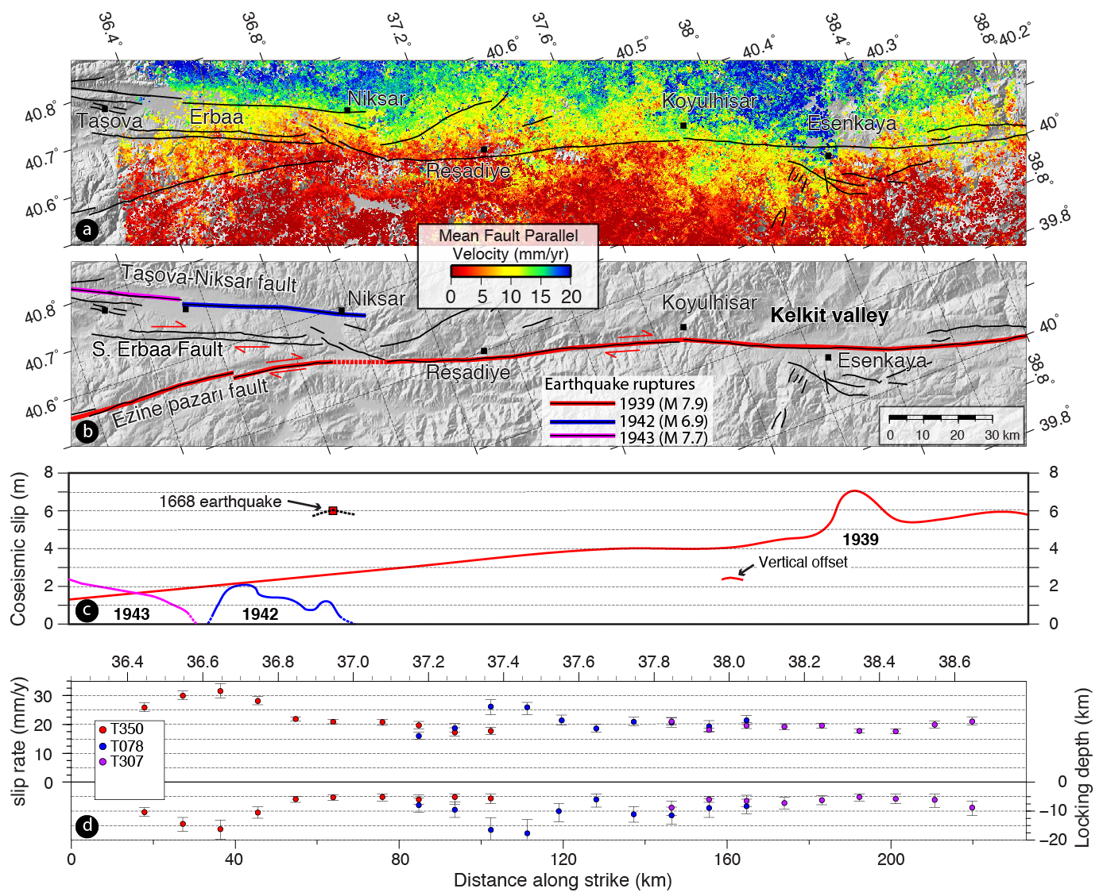
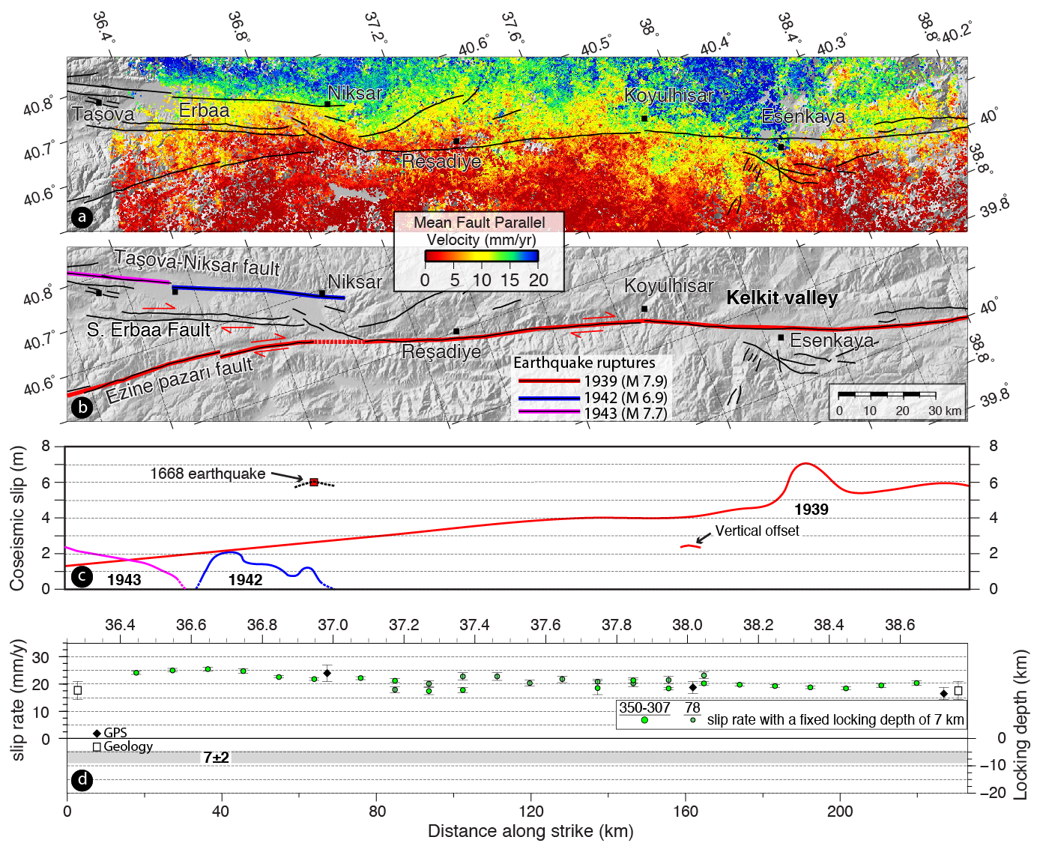
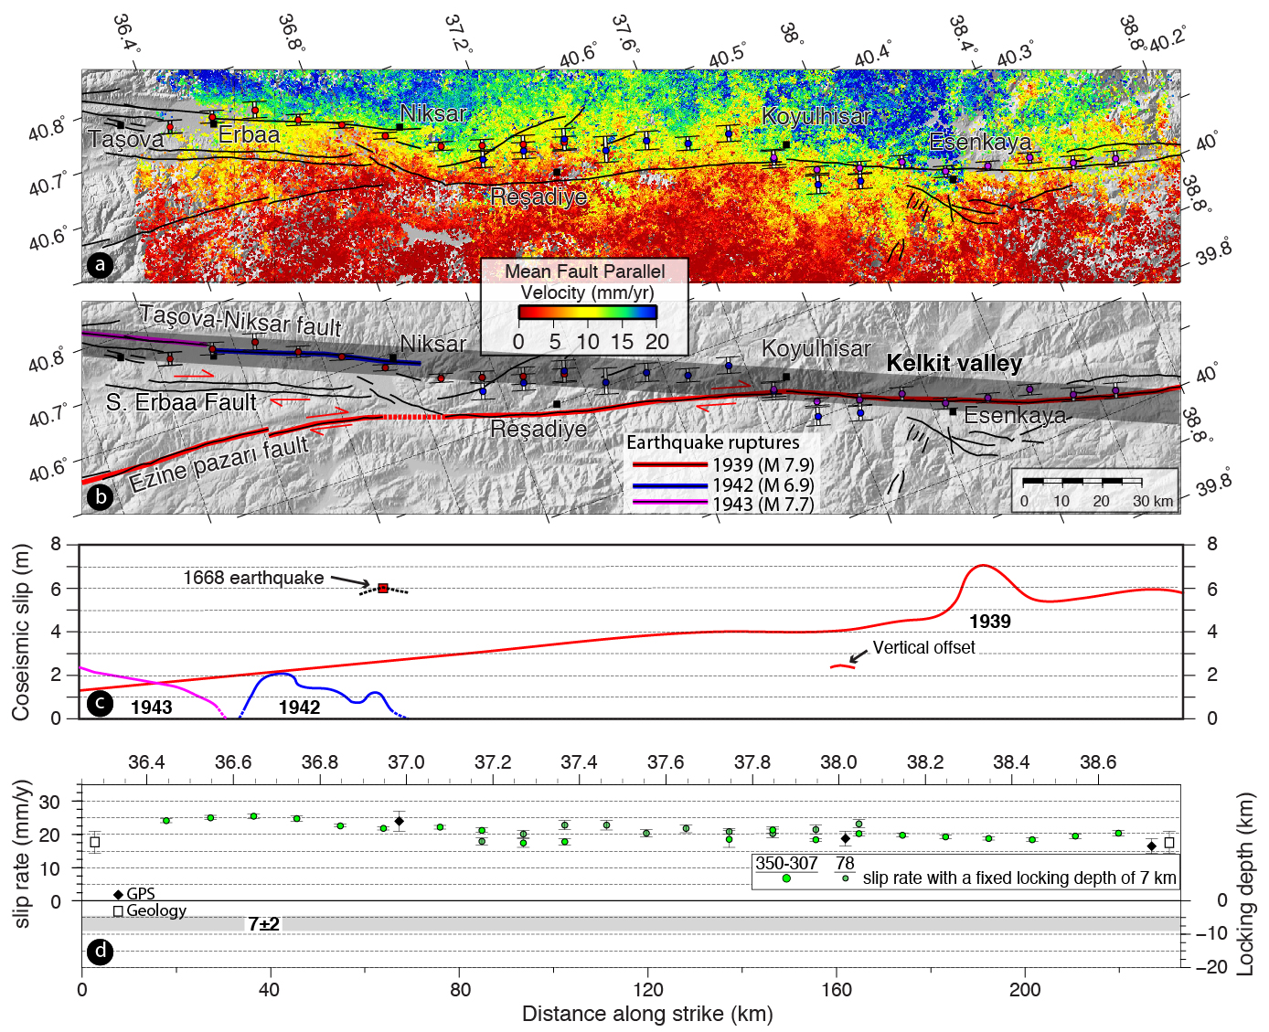
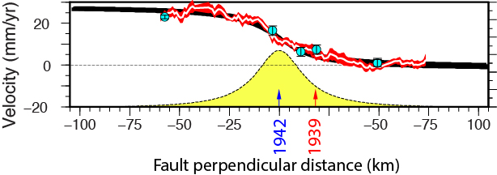
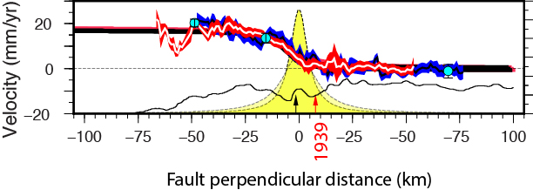
InSAR measurements § modelling

Slide 22
Surface/shallow creep along the NAF

Slide 23
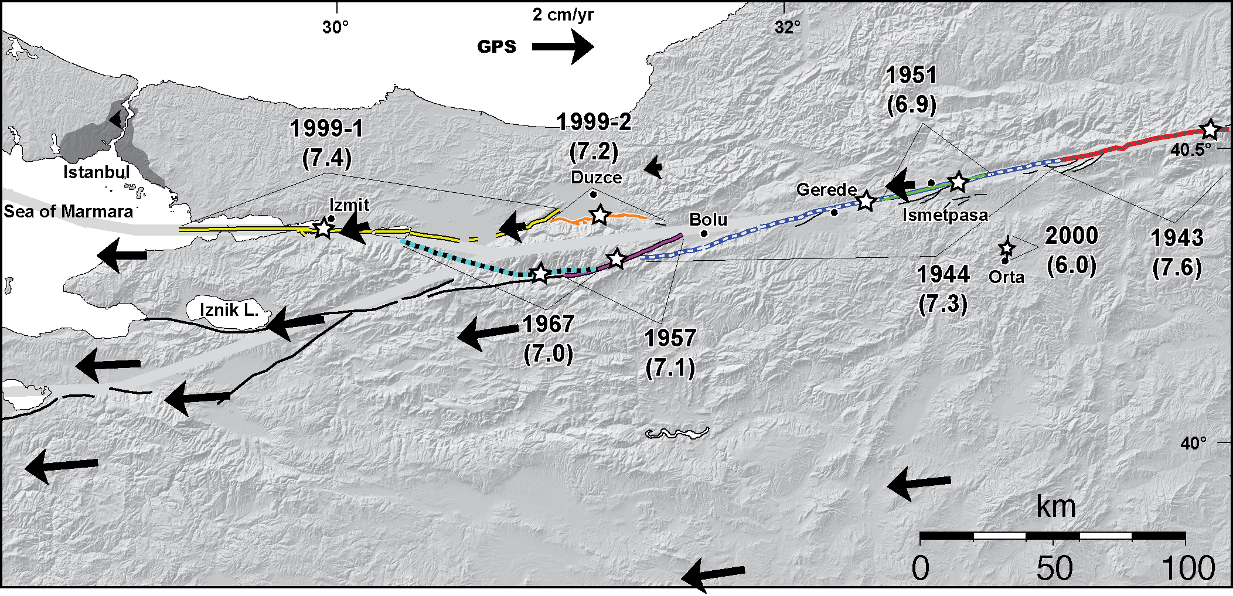
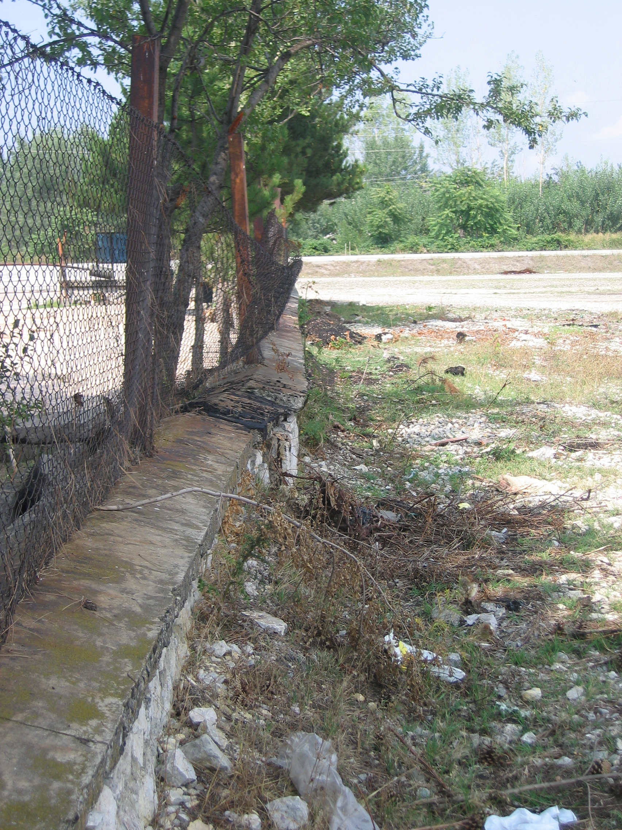
Surface creep at Ismetpaşa
Çakir et al., EPSL, 2005

Slide 24
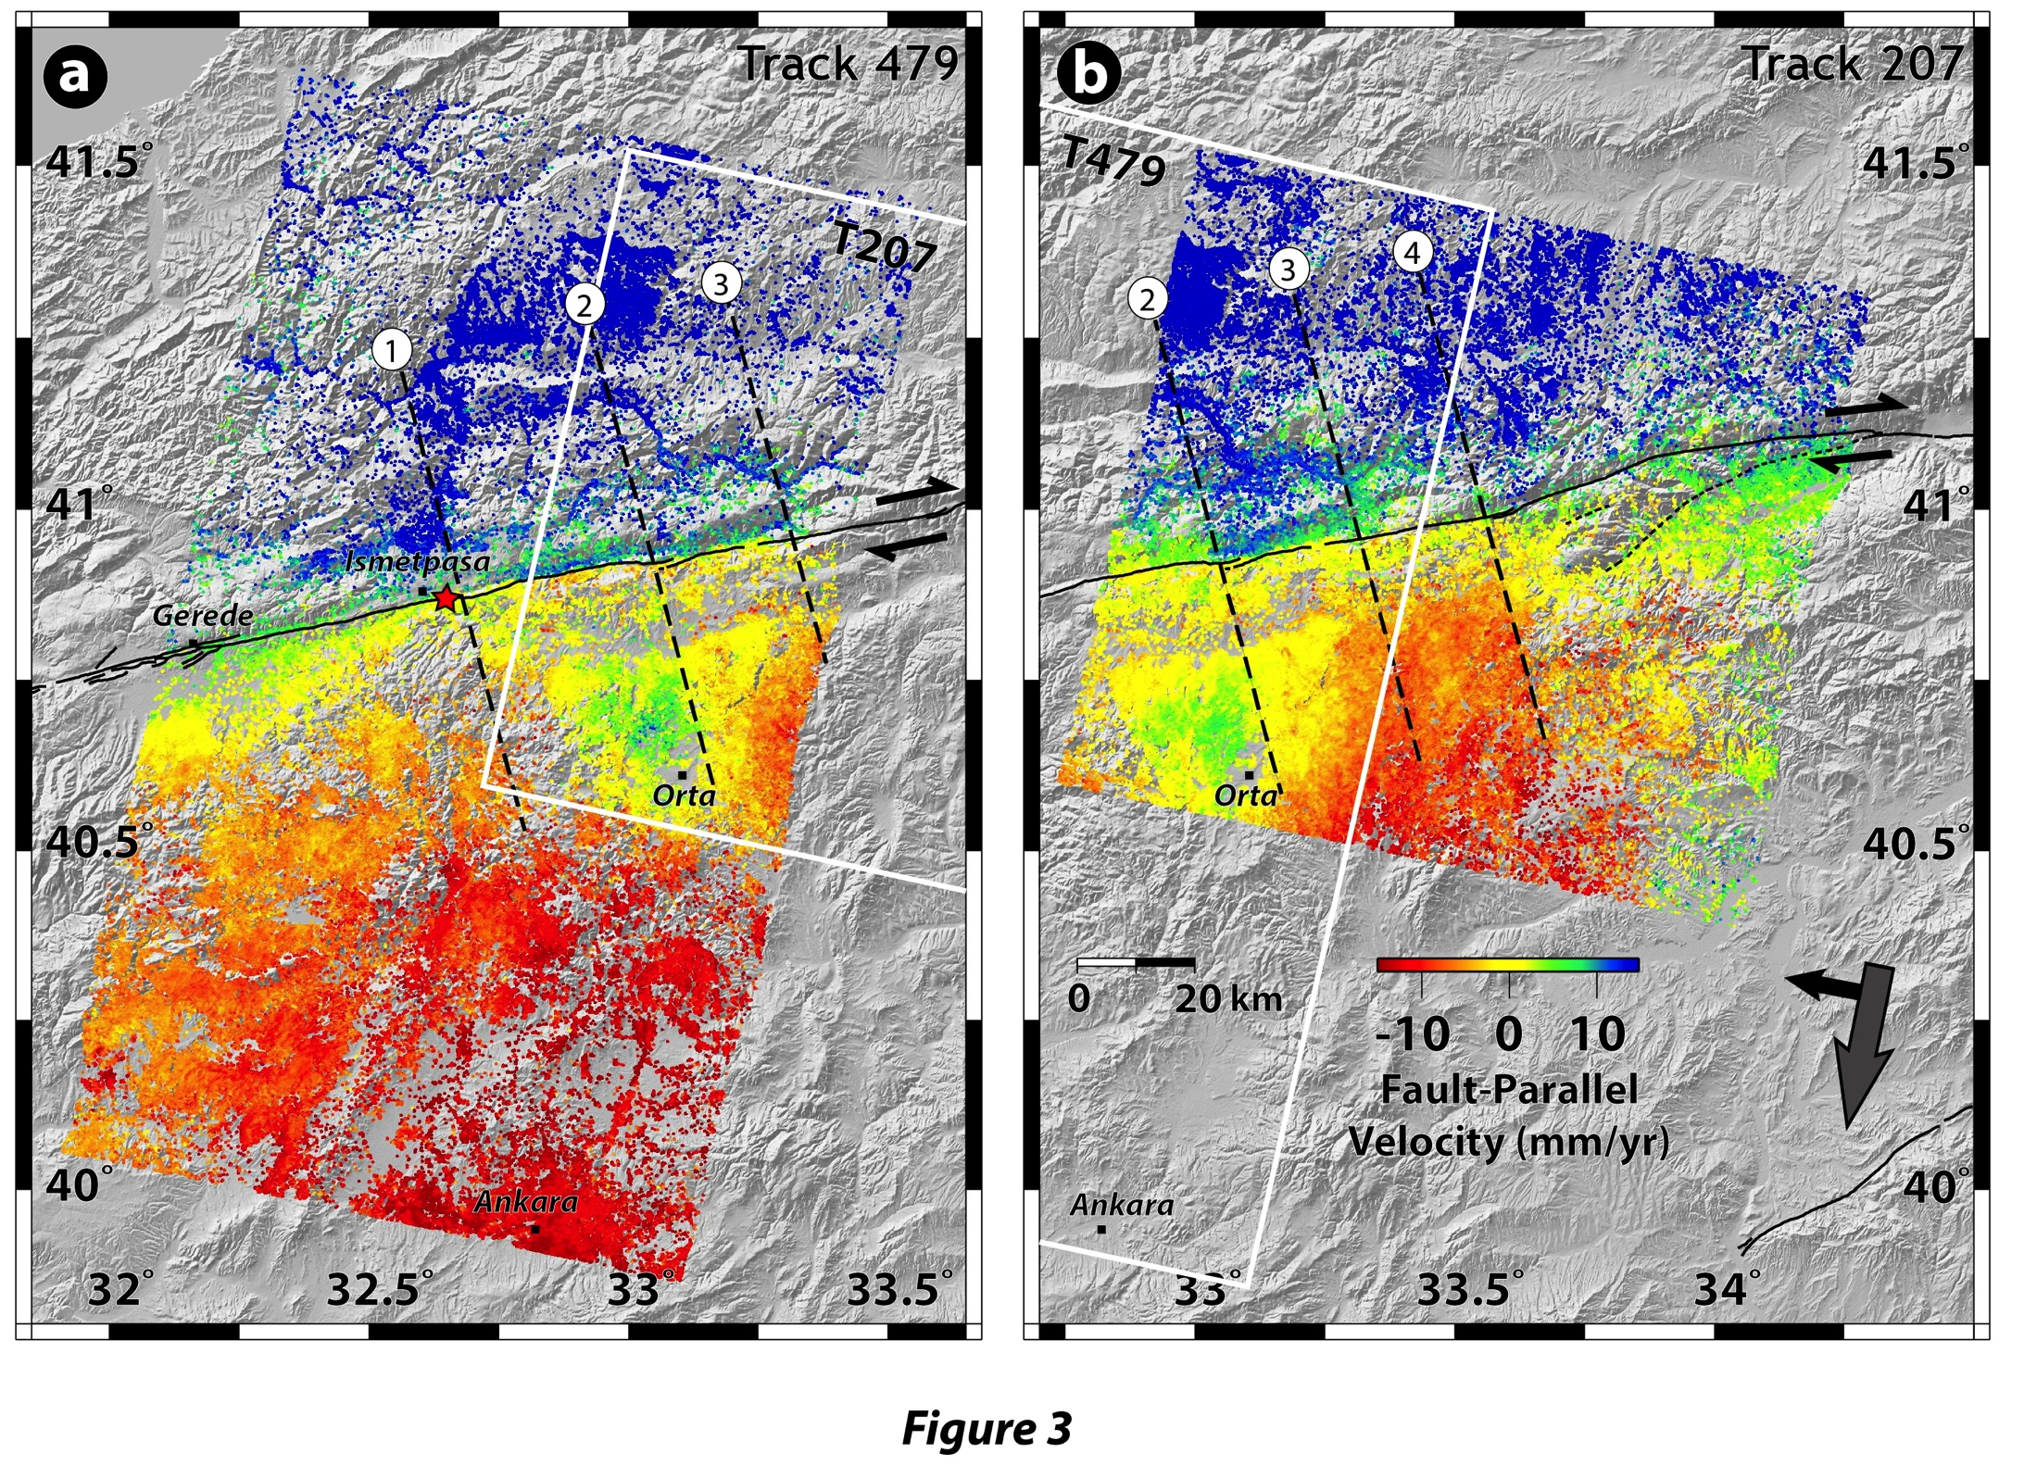
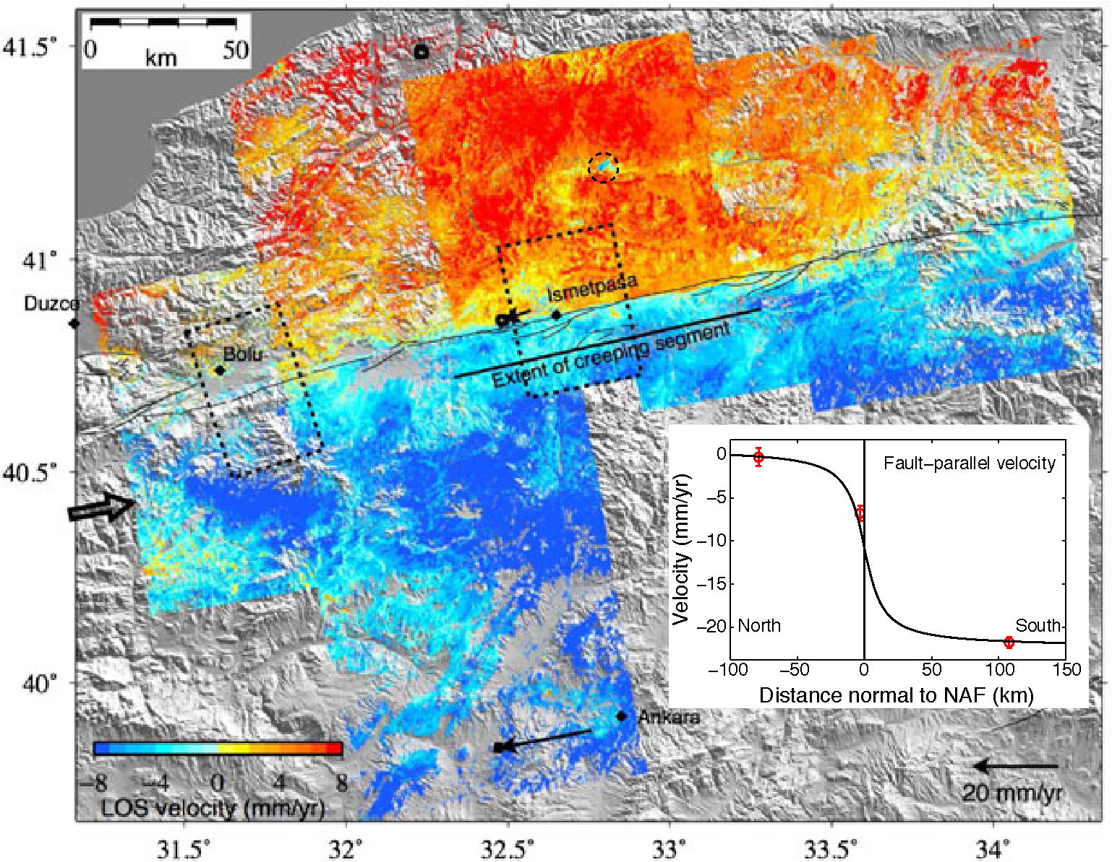
InSAR velocity field across the Ismetpaşa segment
Envisat
PALSAR
Çetin et al., G-cubed, 2014
Kaneko et al., JGR, 2013

Slide 25
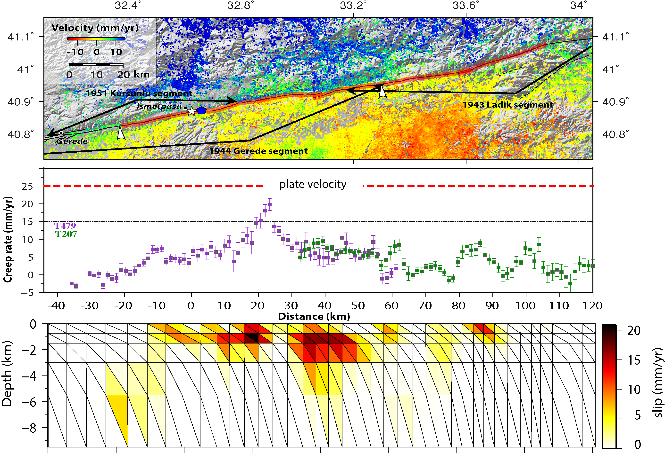
Creep along the Ismetpaşa segment
Çetin et al., G-cubed, 2014

Slide 26
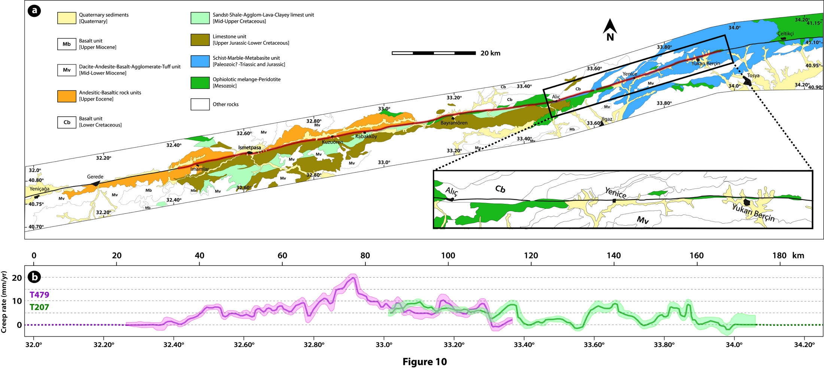
Geology along the fault
Çetin et al., G-cubed, 2014
Saponite!
(M. Kaduri )

Slide 27
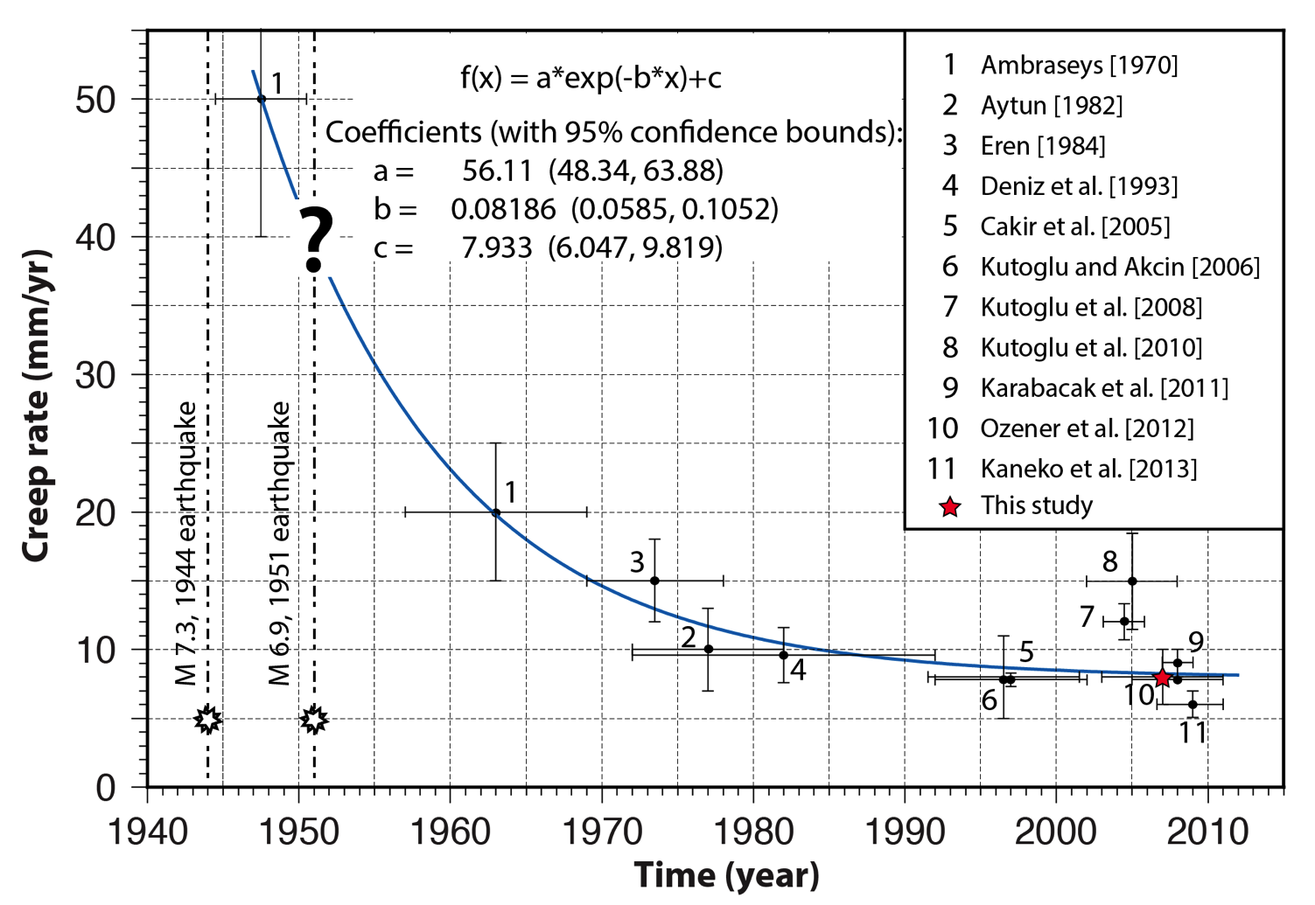
History of creep at Ismetpaşa
Çetin et al., G-cubed, 2014

Slide 28
Postseismic deformation of the 1999 Izmit earthquake
Notes:
Our study region is located on the west of North Anatolian Fault. If we look at enlarged map, it is on the east of 1999 Izmit earthquake rupture.
Here the square shows our study area and these are the Envisat SAR tracks locations that we used.

Slide 29
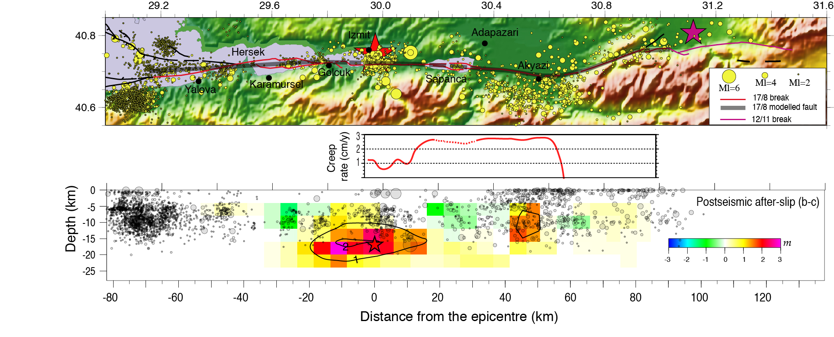
Postseismic deformation of the 1999 Izmit earthquake
Çakir et al., JGI, 2003
Postseismic afterslip during one month following the Izmit earthquake

Slide 30
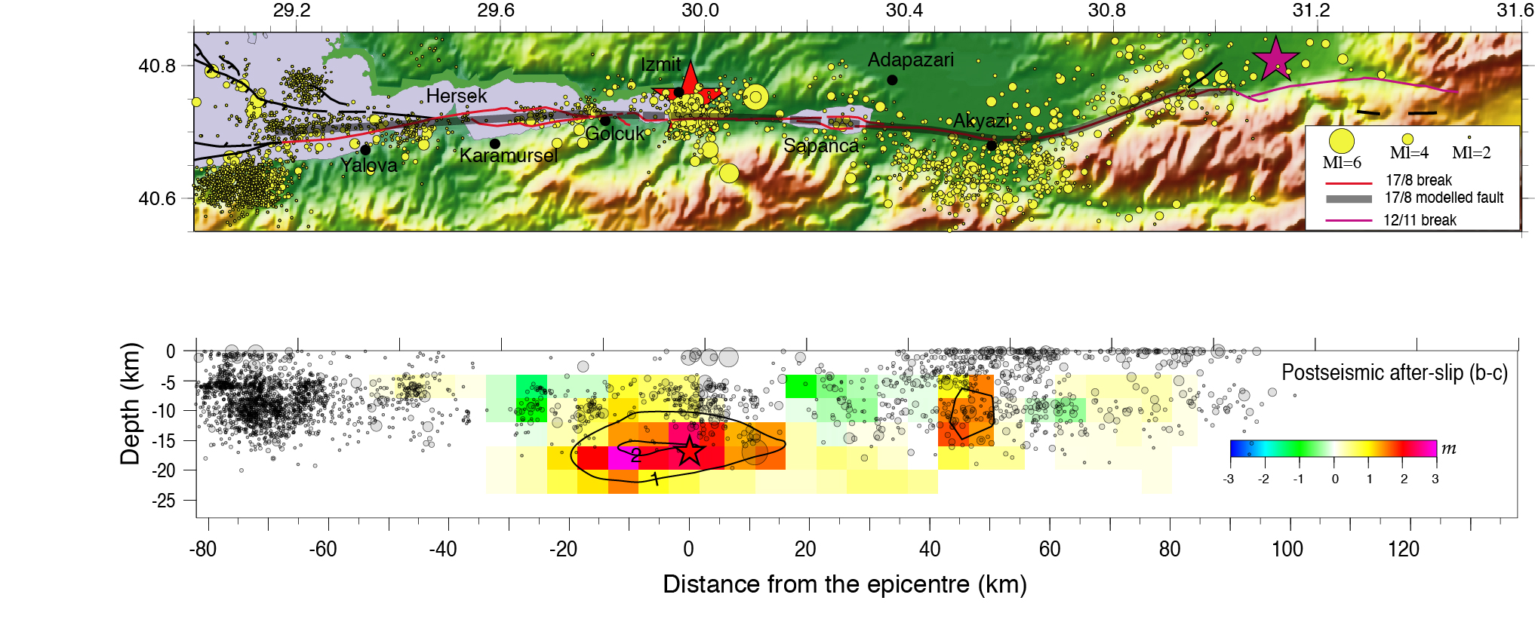
Postseismic deformation of the 1999 Izmit earthquake
Postseismic afterslip during one month following the Izmit earthquake
Çakir et al., JGI, 2003

Slide 31
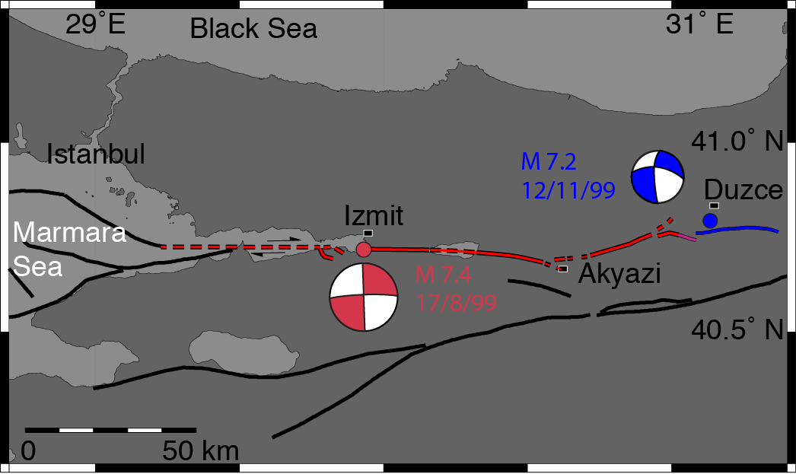
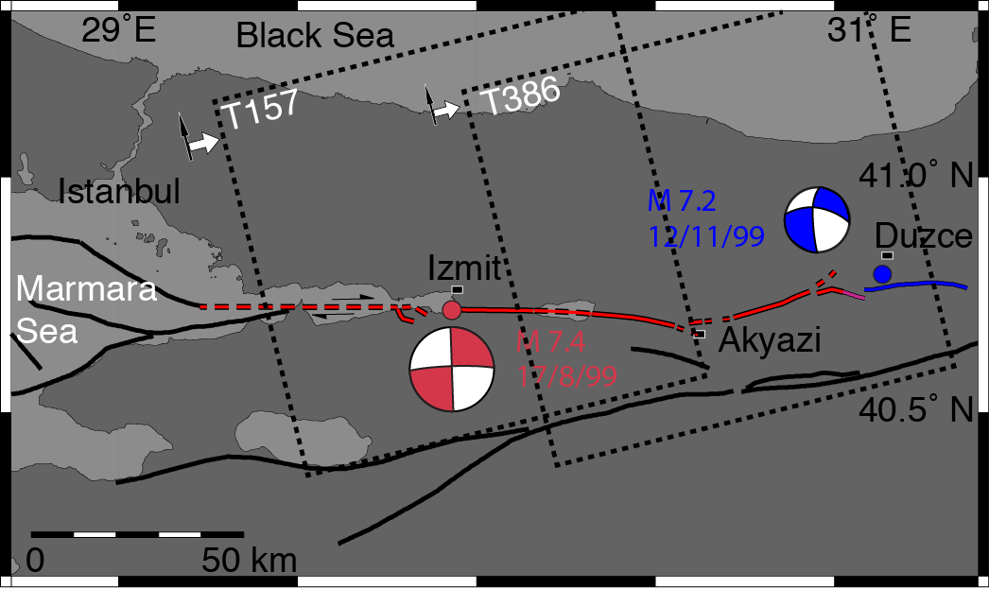
Postseismic deformation of the 1999 Izmit earthquake
Envisat
Envisat

Slide 32
Evidence for surface creep along the 1999 rupture
Çakir et al., Geology, 2010

Slide 33
Any creep before the Izmit earthquake?
ERS1-2

Slide 34
Creep on the Izmit fault
Çakir et al., Geology, 2010

Slide 35
Geology along the fault
Ofiolites and ultramaphic rocks

Slide 36
Seismicity in Marmara Sea
No seismoturbidite since ~1000 yr
(McHugh et al., 2014)
Aseismic
slip?
(HypoDD locations by H. Karabulut et al., 2014)

Slide 37
Creep on the Central Marmara Fault?
Ergintav et al., GRL, 2014
No significant strain accumulation
(A. Deschamps)

Slide 39
Creep along the North and East Anatolian faults
?

Slide 40
Summary
Surface creep may commence as afterslip and continue for a long time
Presence of weak minerals may be responsible for creep along the NAF
Along-strike fault complexity observed at the surface is not apparent at depth. Therefore, fault segmentation is likely controlled by preexisting heterogeneities and structures in the upper crust.
Linear and concentrated trough-going shear zone supports the idea that continental strike-slip faults extend as discrete narrow features through the entire crust.
Subsidiary faults and their slip history may play a critical role in determining the size of earthquakes on major faults.

