Slide 1
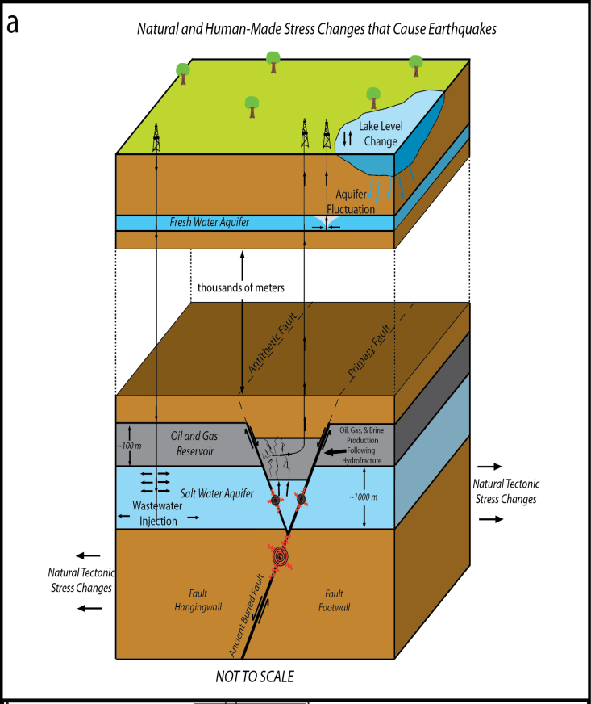

Induced Seismicity: Fundamentals, New Observations and Outstanding Challenges
William L. Ellsworth
U. S. Geological Survey

Slide 2
Outline
Earthquake Hazard and Induced Earthquakes
Mechanics of induced earthquakes
Three ongoing case studies
  Paradox Valley, Colorado
  Recent activity near Azle, Texas
  Evolution of Oklahoma seismicity
Think locally, act globally

Slide 3
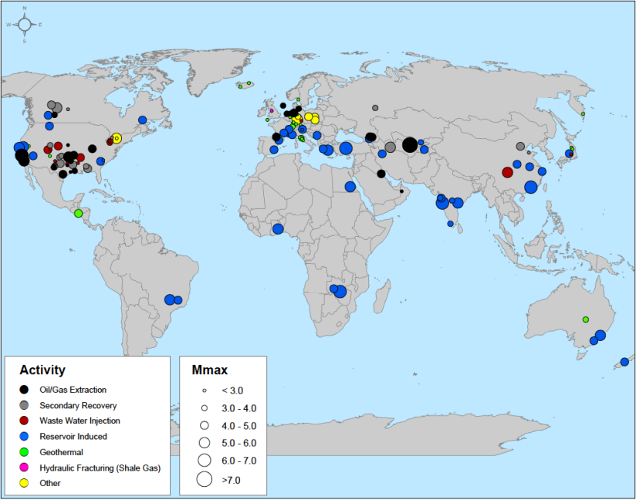
Examples of Recent Induced (or Suspected) Earthquakes
Basel, Switzerland (injection for Enhanced Geothermal System)
Lorca, Spain (groundwater withdrawal)
Offshore Valencia, Spain (gas storage)
Groningen, The Netherlands (gas production)
Northern Germany & Southwestern Poland (mining)
Fjallbacka, Sweden (geothermal production)
Blackpool, England (hydraulic fracturing)
Salah, Algeria (CO2 sequestration)
Committee on Induced Seismicity Potential in Energy Technologies, Induced Seismicity Potential in Energy Technologies [National Research Council] (2012).

Slide 4
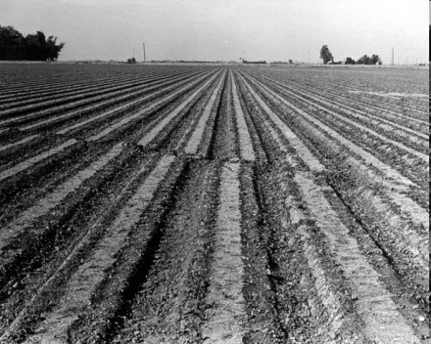
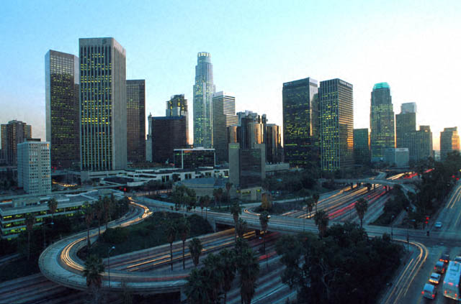
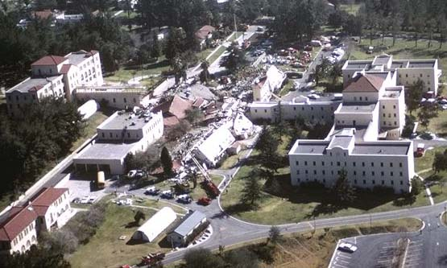
What is hazard?
How does it differ from risk?
Hazard = A source of potential danger or harm
Risk = Chance of suffering loss or harm
Risk = Hazard × Exposure × Fragility
Faulting, shaking landsliding liquifaction
innundation
Extent & density of built environment
Structural fragility
Non-structural vulnerability

Slide 5
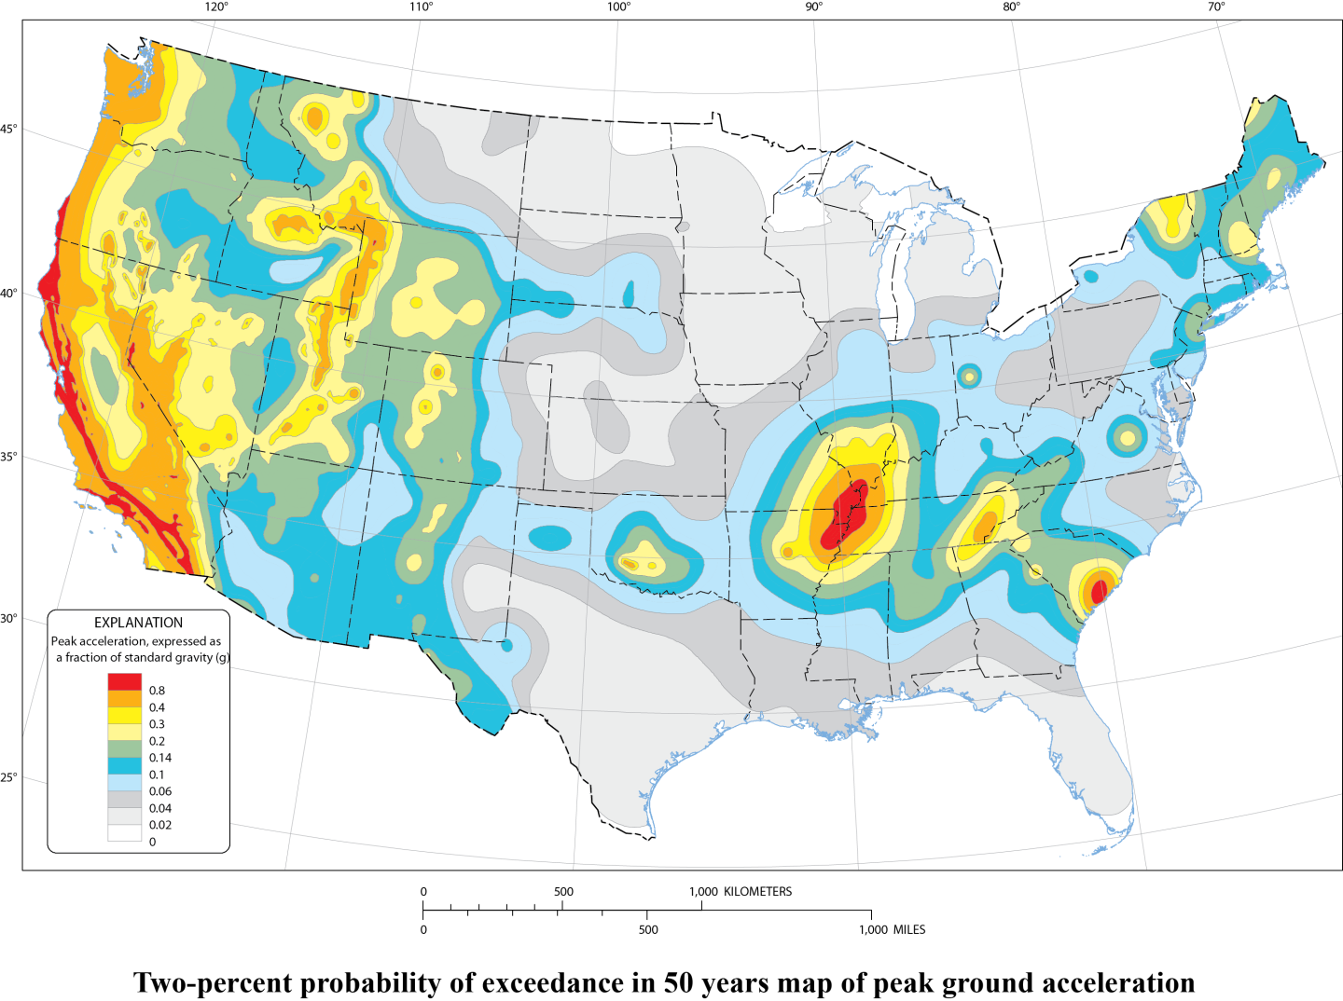
U. S. Earthquake Hazard Map

Slide 6
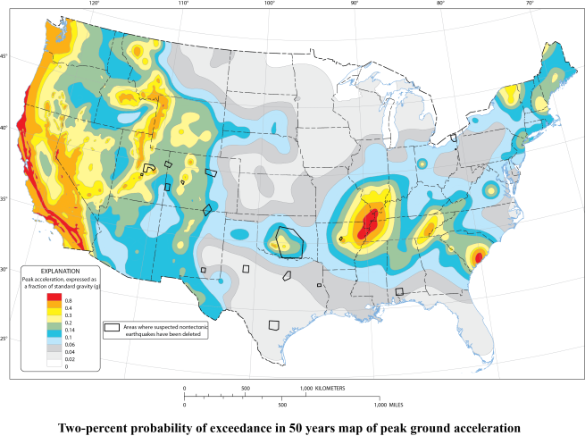
What’s shown on a Hazard Map?
Estimate of earthquake shaking hazard
  Quantified as a probability of strength of shaking in a certain number of years
Primary purpose is to set the seismic design provisions of building codes
U. S. Map update released in July 2014
Update ducked the question of induced earthquakes

Slide 7
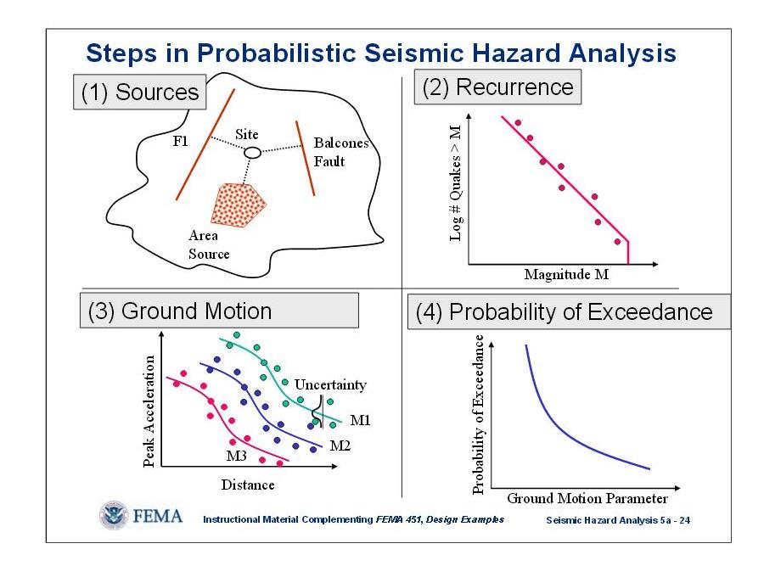
Probabilistic Seismic Hazard Analysis
Where will earthquakes occur in the future?
How often will they happen and how large can they get?
How hard will they shake the ground?
When answers are available for Steps 1-3: Add up all of the sources to find the probability of exceeding damaging shaking.

Slide 8
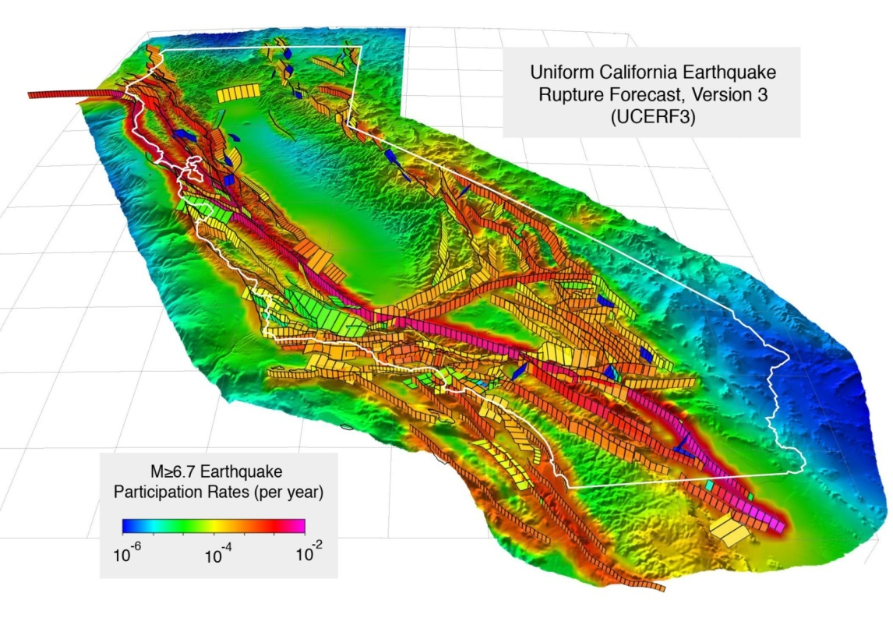
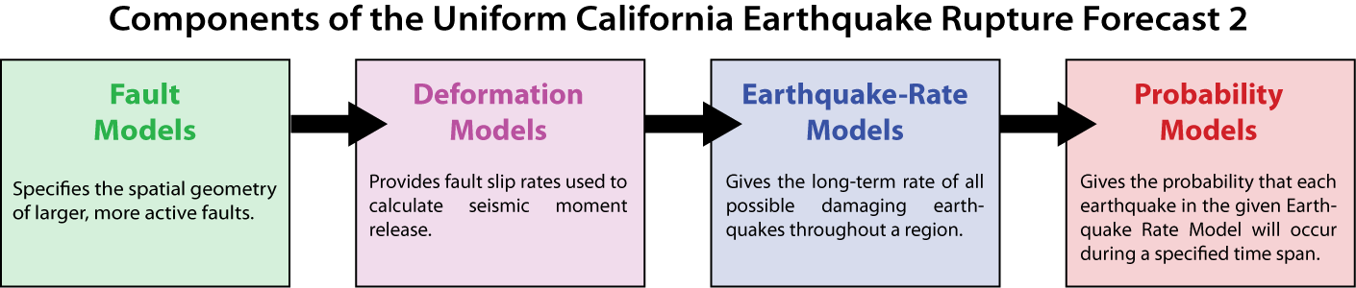
Hazard Mapping in the Data-Rich California

Slide 9

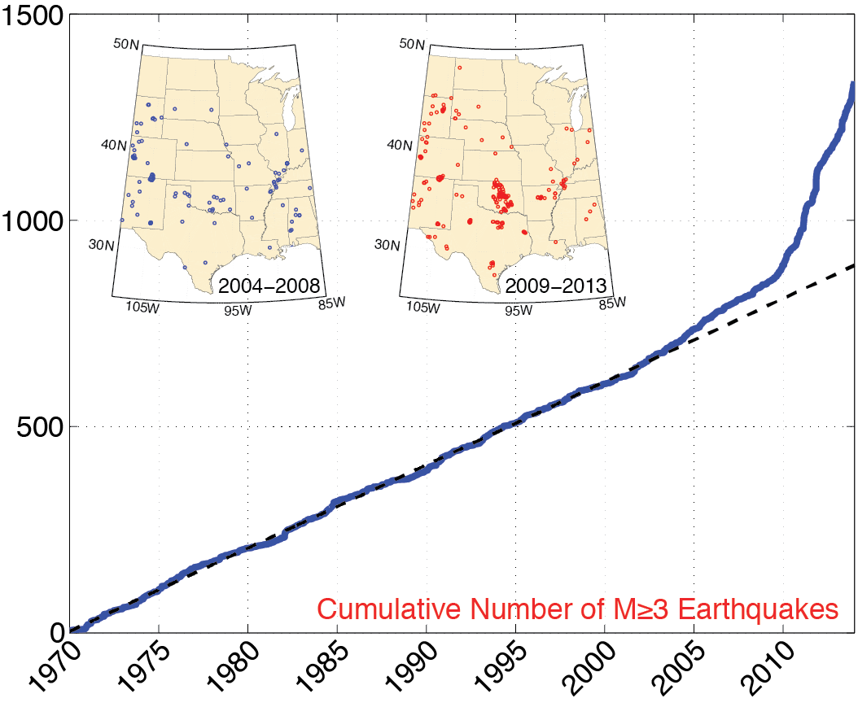
Hazard model for the central and eastern U. S. primarily based on past seismicity
What rate of earthquakes should be expected in the future?

Slide 10
Hazard model for the central and eastern U. S. primarily based on past seismicity
Higher rate of earthquakes implies higher hazard.
But how much higher?
And where has the hazard increased?

Slide 11
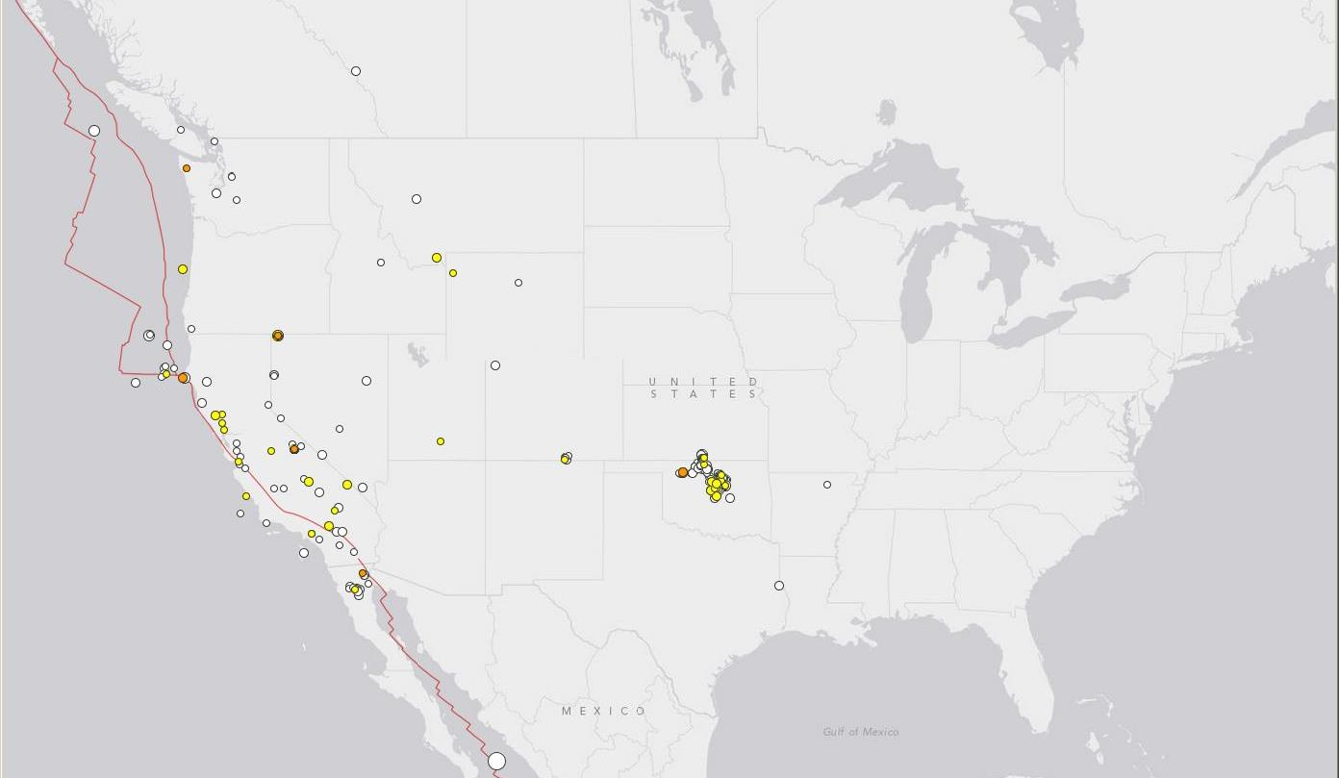
Increased Earthquake Activity in the U. S. Midcontinent
Higher rate of earthquakes implies higher hazard.
But how much higher?
And where has the hazard increased?
Earthquakes for October, 2014
Magnitude ≥ 2.5

Slide 12
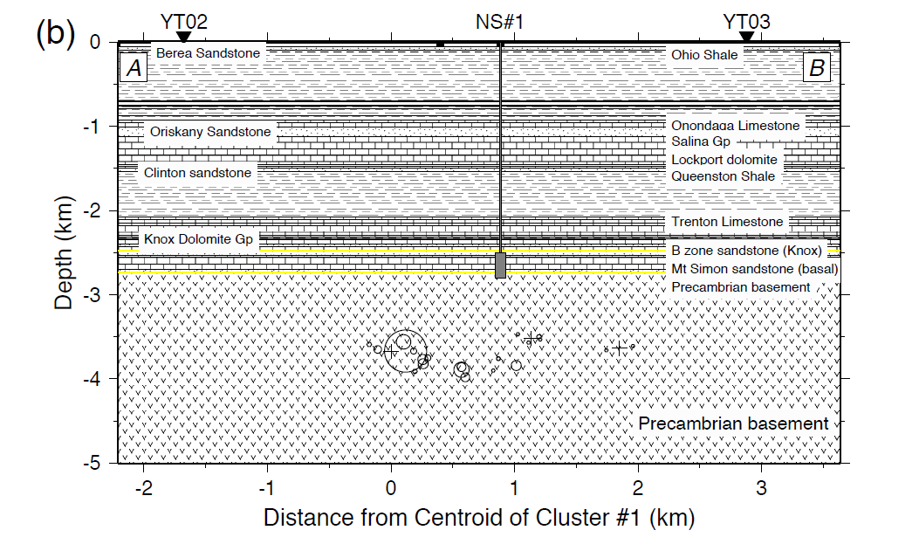
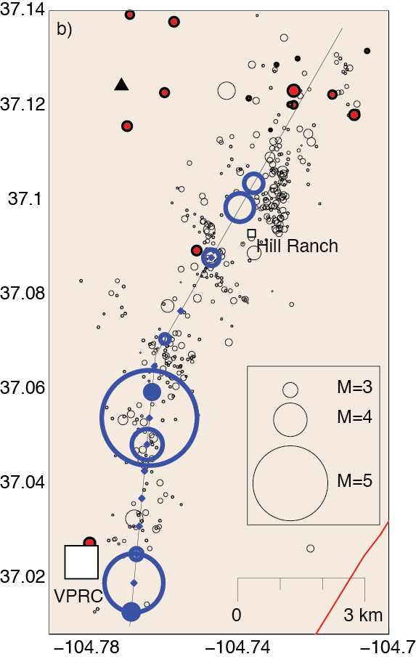
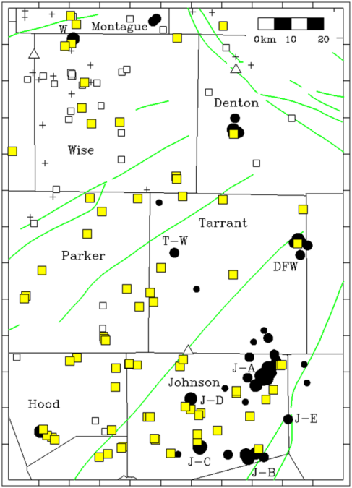
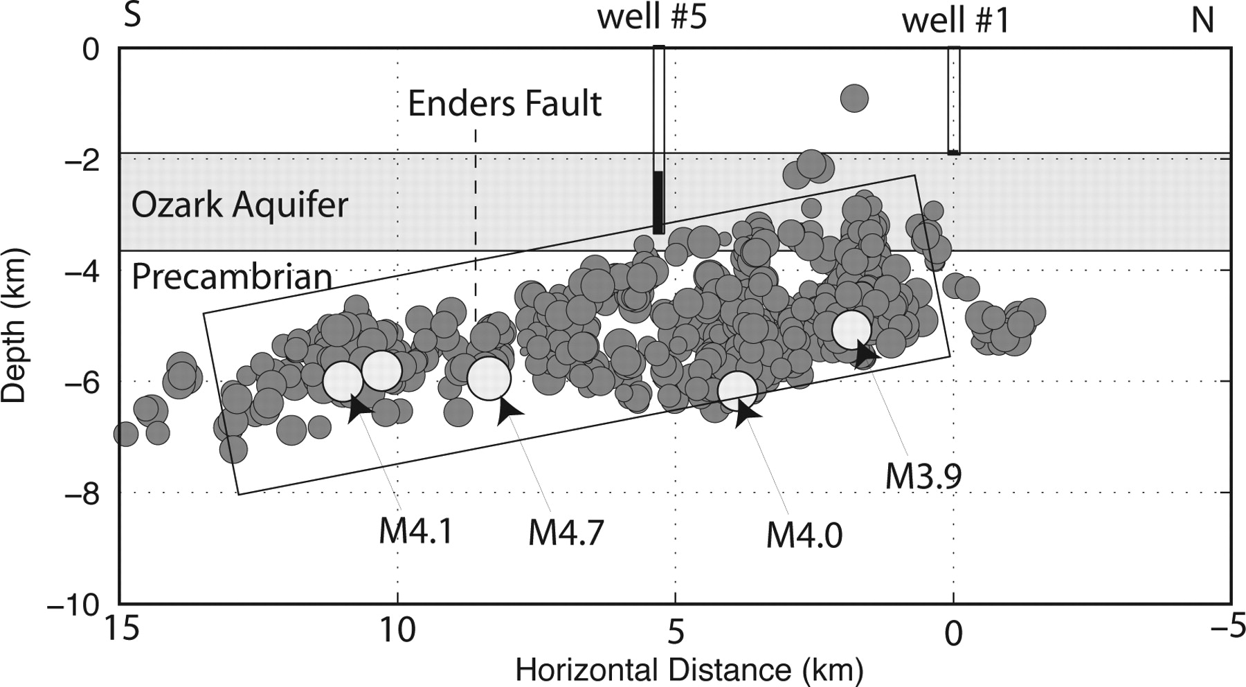
W.-Y. Kim, Induced seismicity associated with fluid
injection into a deep well in Youngstown, Ohio.
J. Geophys. Res. 10.1002/jgrb.50247 (2013)
Rubinstein, J. L., Ellsworth, W. L., McGarr, A., and Benz, H., 2014, The 2001 – Present Triggered Earthquake Sequence in the Raton Basin of Northern New Mexico and Southern Colorado, Bull. Seismol. Soc. Am.
Horton, S., 2012, Disposal of Hydrofracking Waste Fluid by Injection into Subsurface Aquifers Triggers Earthquake Swarm in Central Arkansas with Potential for Damaging Earthquake; Seismological Research Letters, v. 83.
Frohlich, C., 2012, Two-year survey comparing earthquake activity and injection-well locations in the Barnett Shale, Texas. Proc. Natl. Acad. Sci.

Slide 13
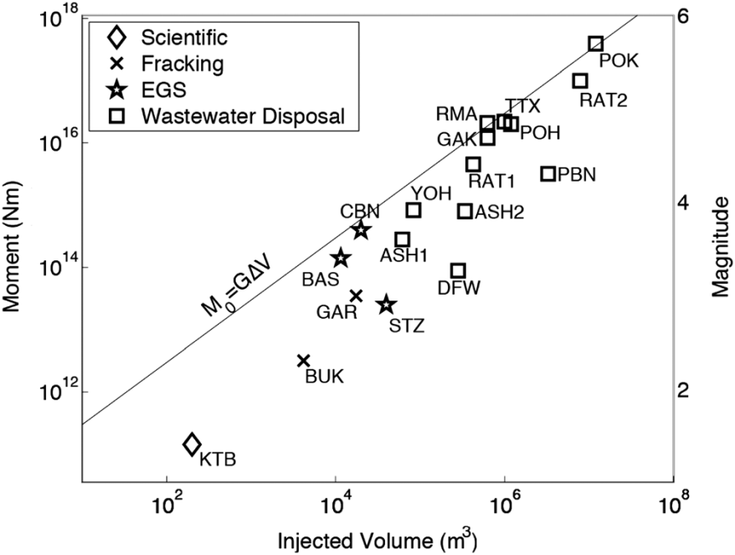
Induced seismicity presents some formidable challenges as the location of future activity, its duration and magnitude distribution are poorly know at present.
McGarr proposed that the maximum magnitude is limited by the total injected volume.
Kerenan et al. proposed fewer wells were involved in inducing the largest injection-induced earthquake in Oklahoma.
McGarr, 2014, Maximum magnitude earthquakes induced by fluid injection, J. Geophys. Res.
Keranen, K.M., Savage, H.M., Abers, J.A., and Cochran, E.S., 2013, Potentially induced earthquakes in Oklahoma, USA: Links between wastewater injection and the 2011 Mw 5.7 earthquake sequence, Geology., doi:10.1130/G34045.1

Slide 14
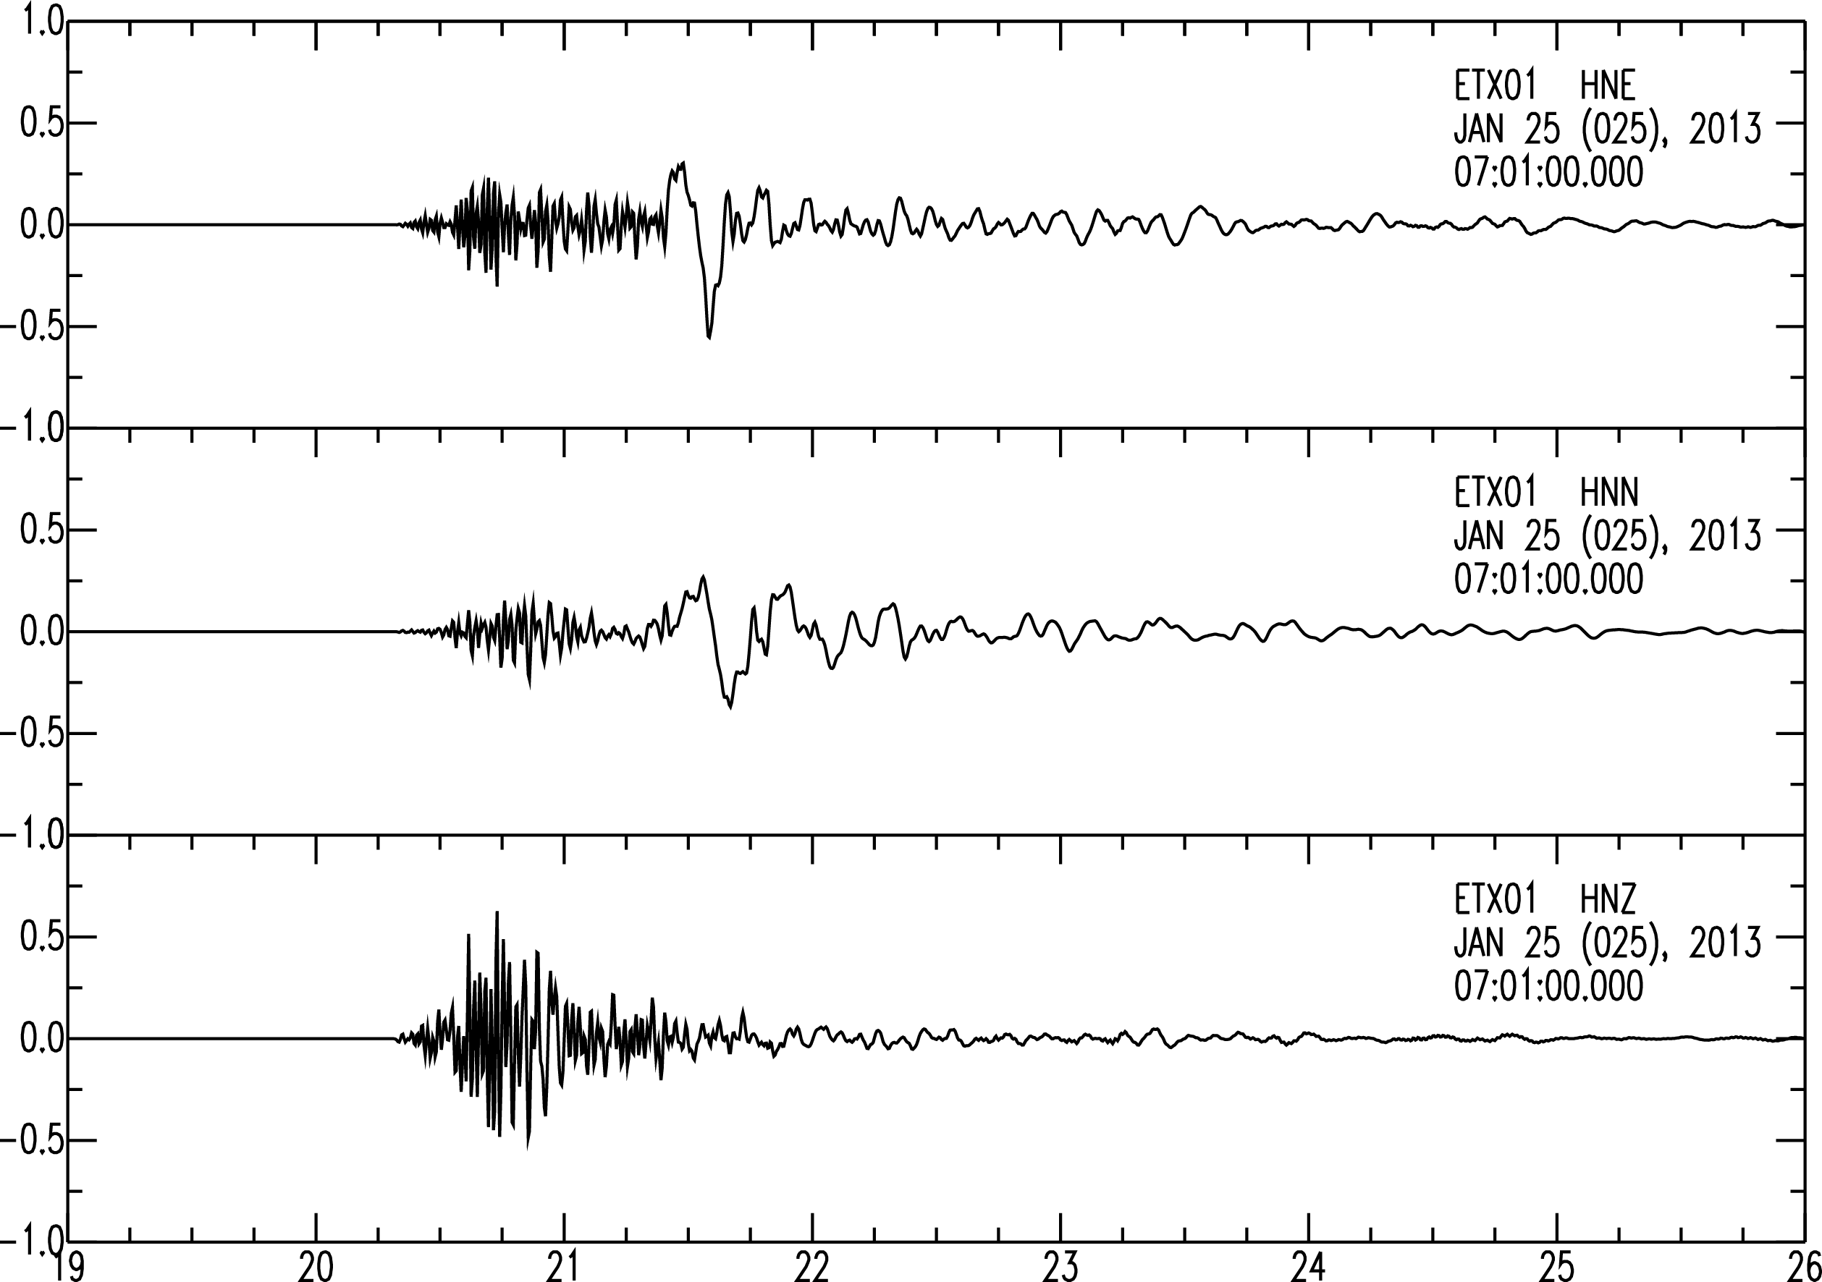
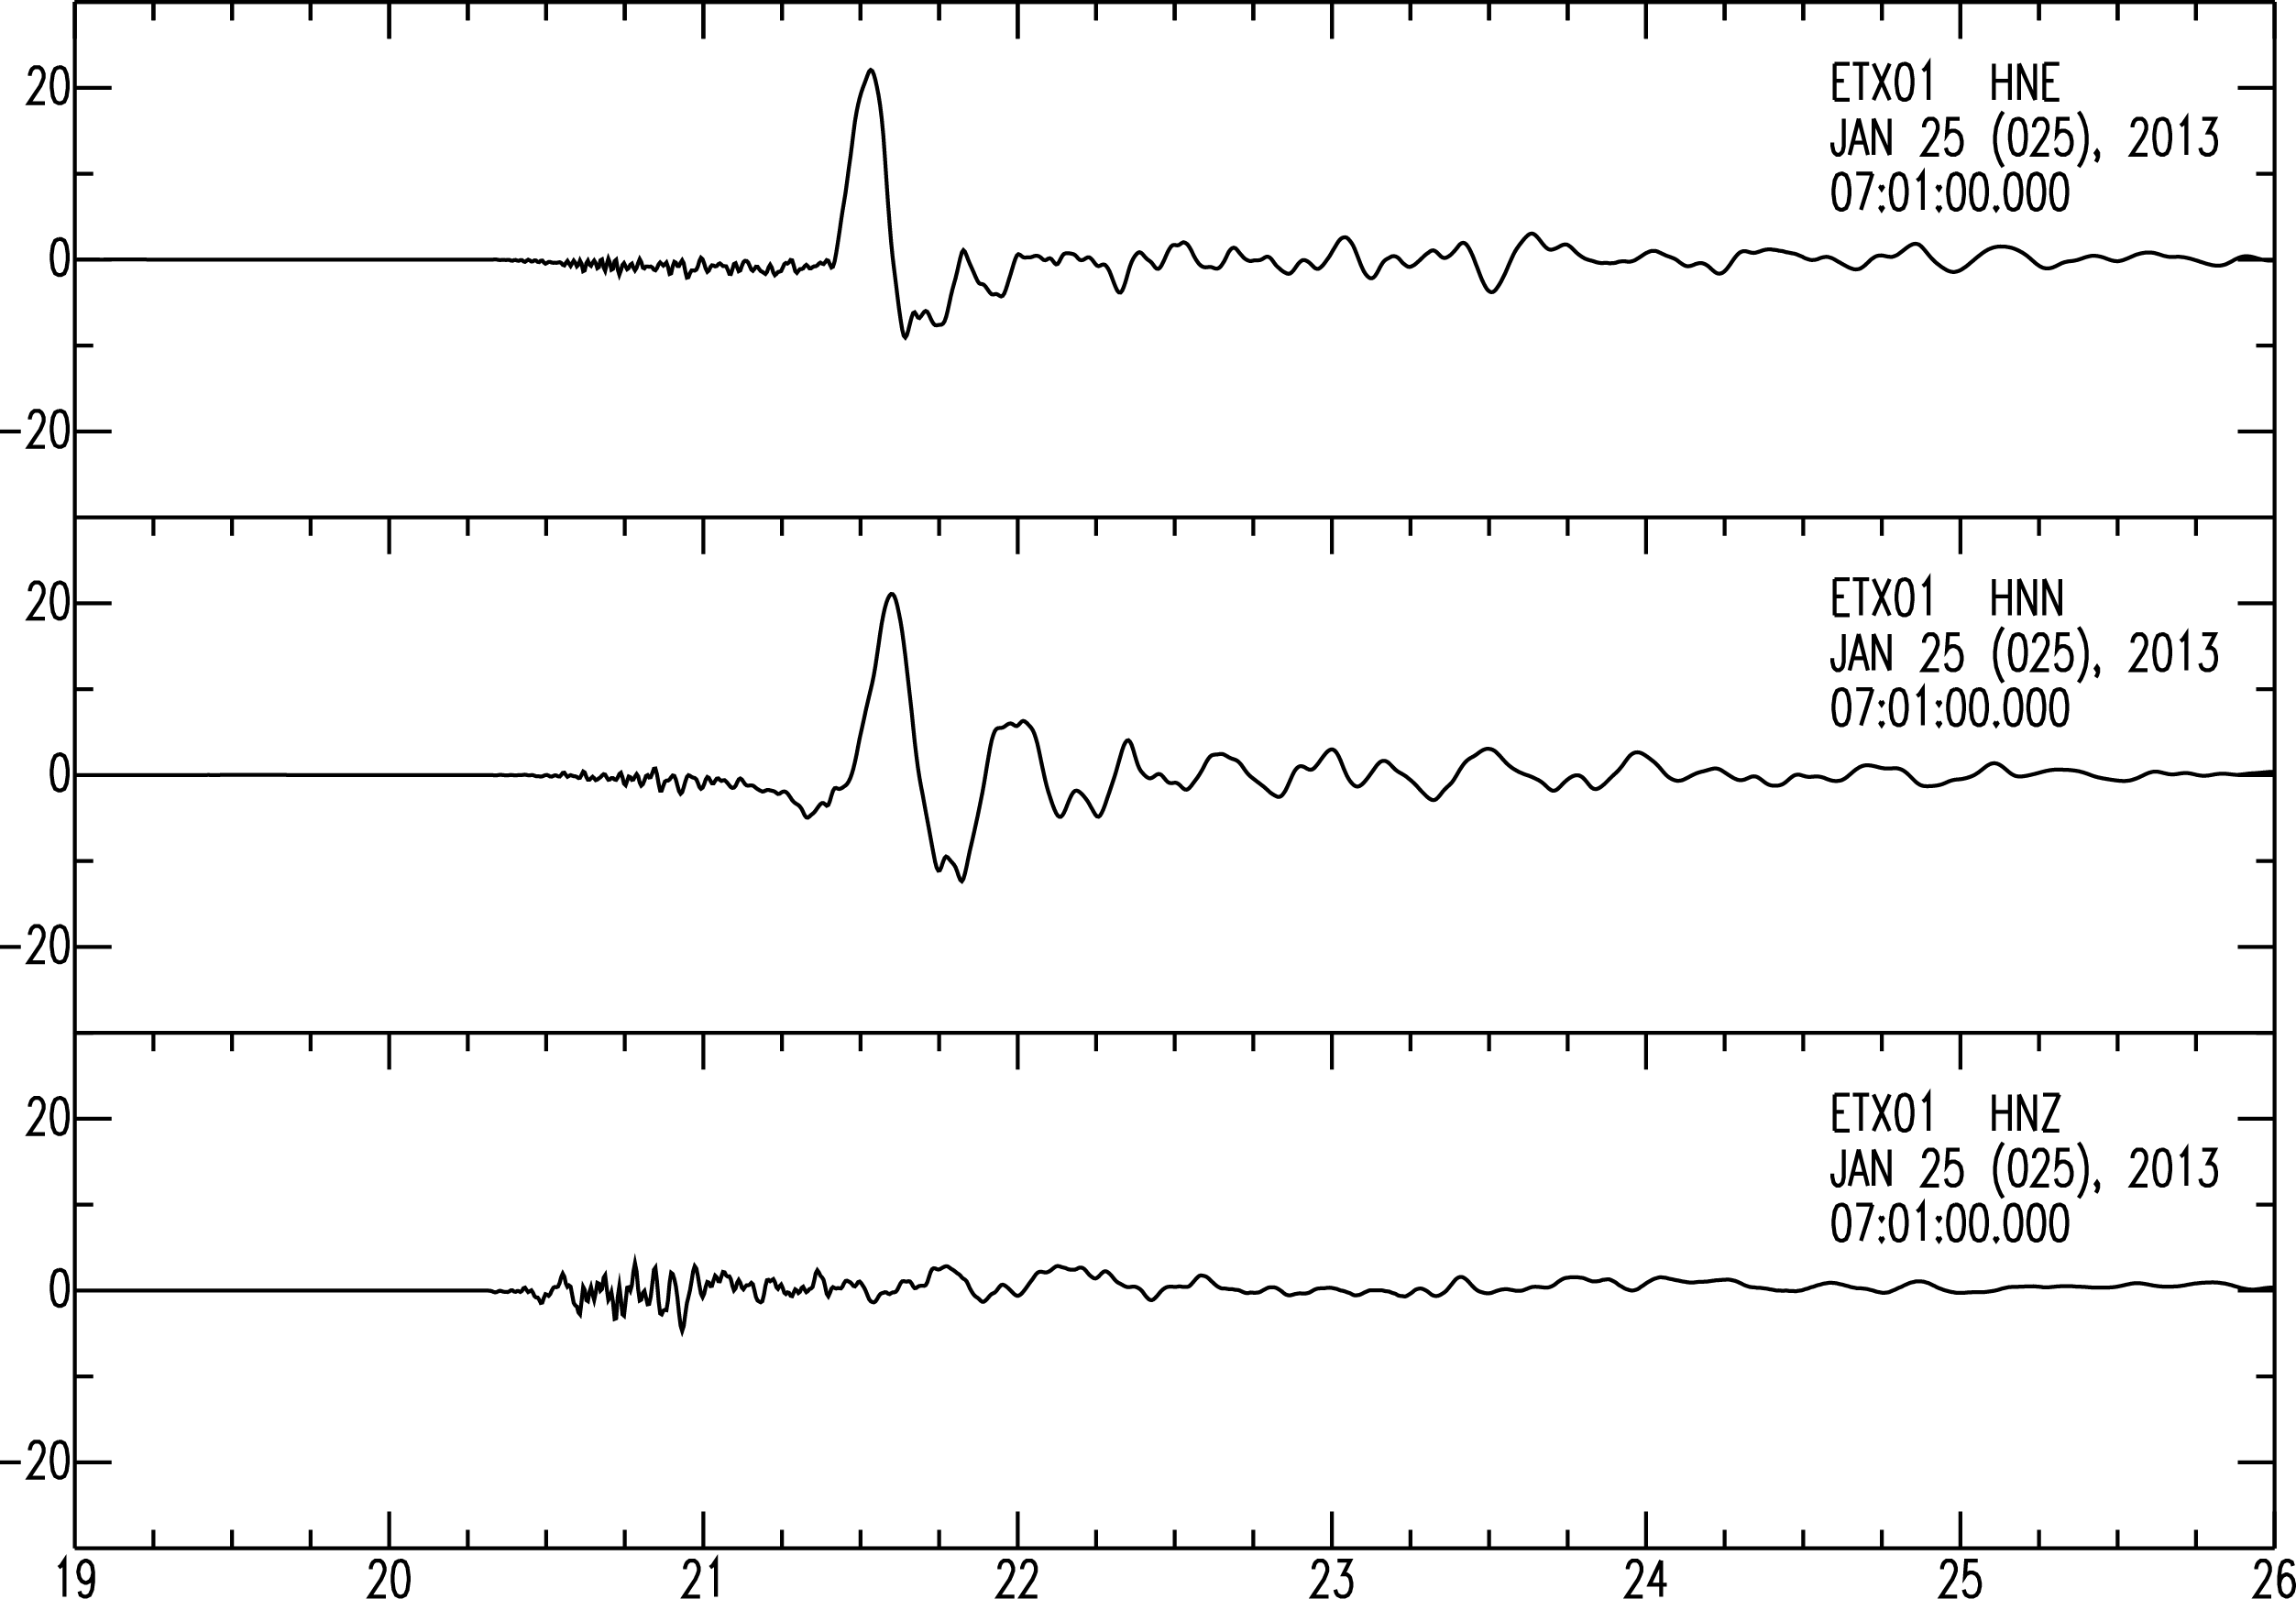
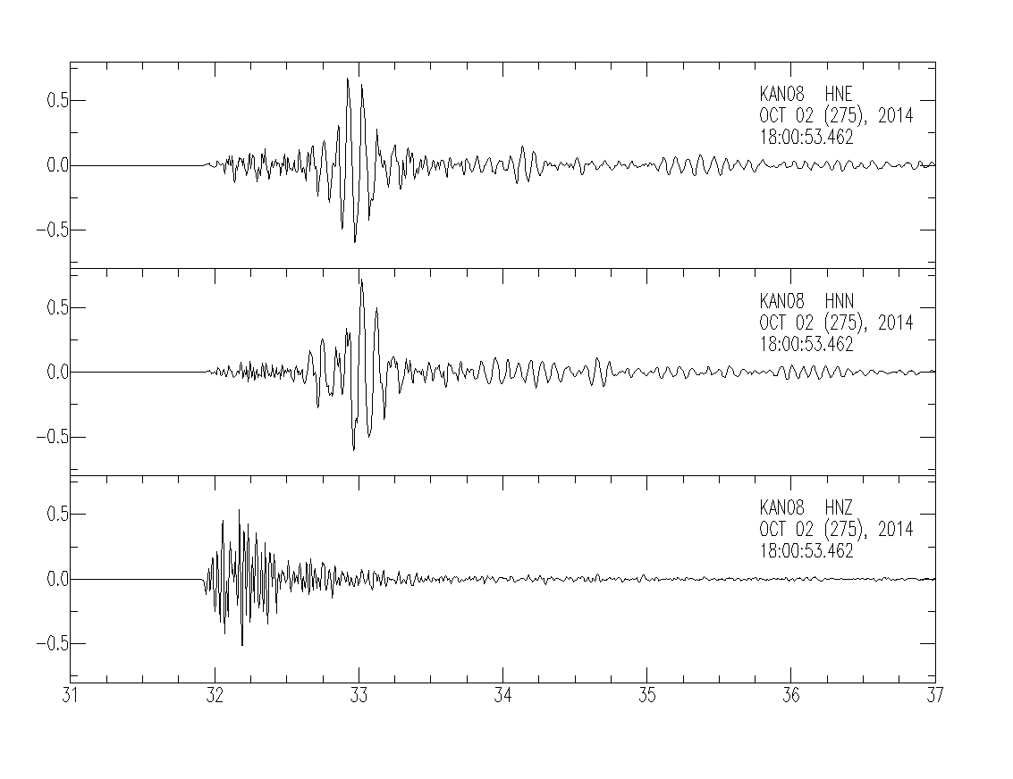
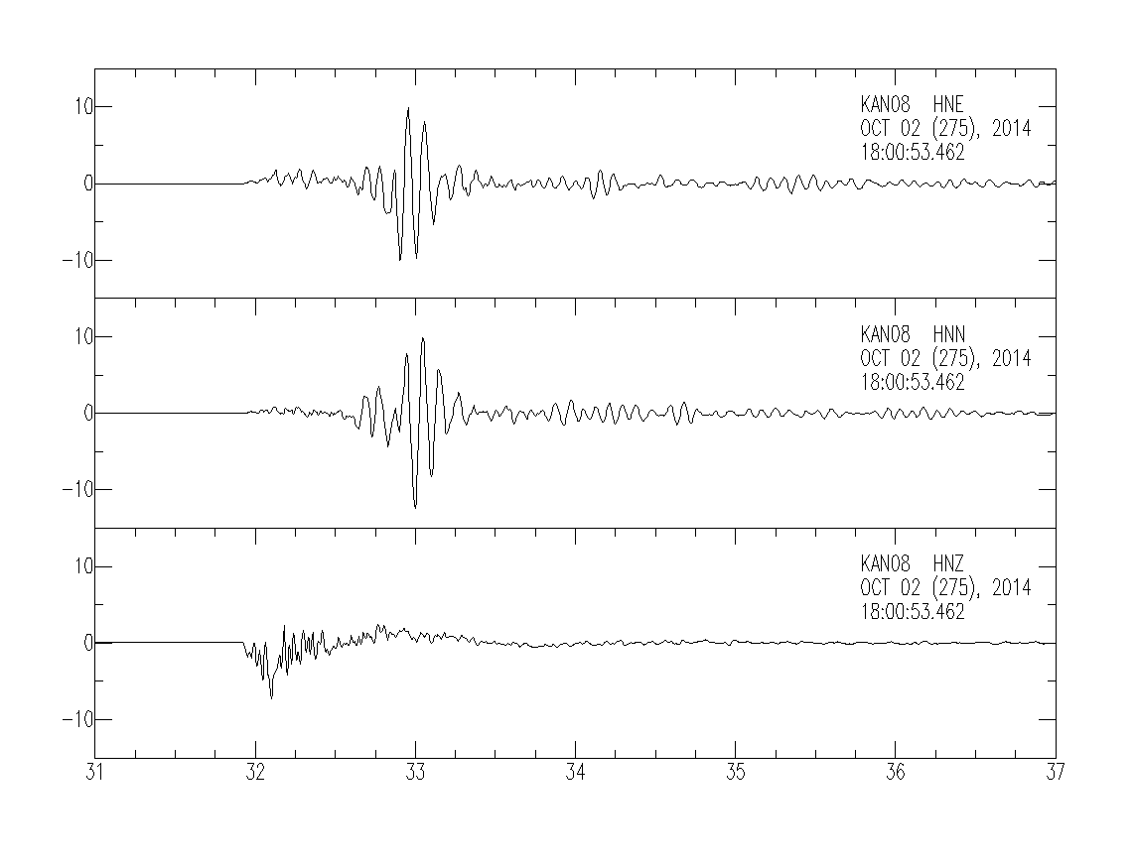
Progress is being made in determining the ground motion prediction equations from near-source recordings of induced earthquakes.
55% g
Acceleration
62% g
Velocity
Acceleration
Velocity
22 cm/s
70% g
12 cm/s
M_{w} 4.1 January 25,2013 Timpson, Texas Earthquake
M_{w} 4.3 October 2, 2014
Anthony, Kansas Earthquake

Slide 15
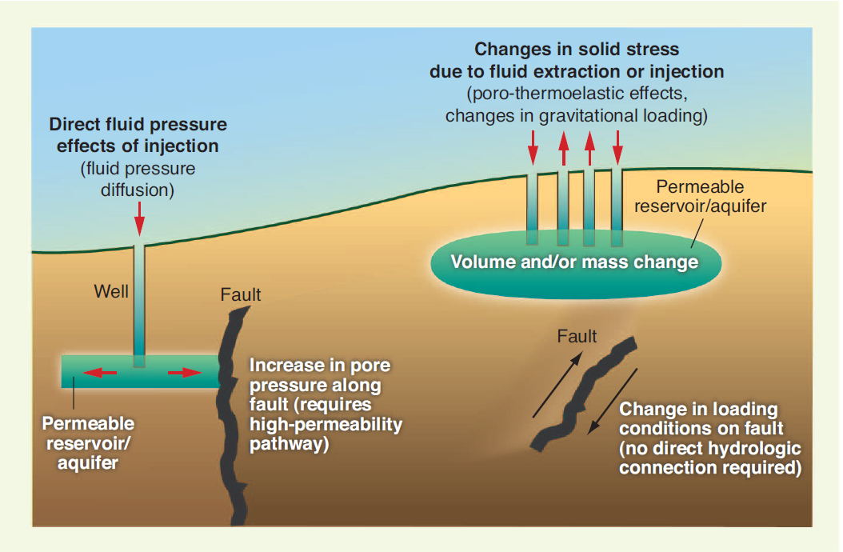
Mechanics of Induced Earthquakes

Slide 16
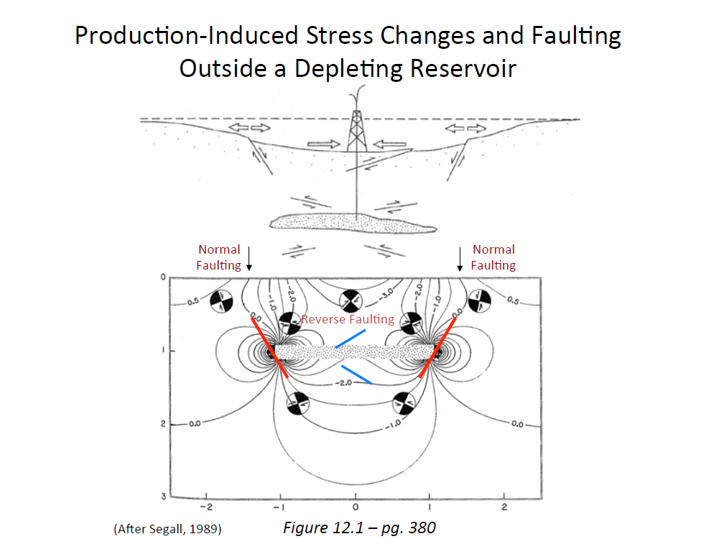
Mechanics of Induced Earthquakes
Bulk Stress Effect

Slide 17
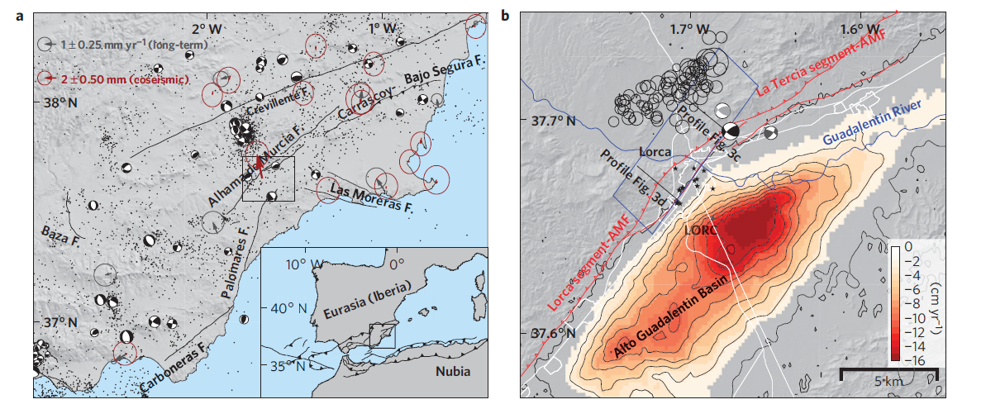
Reverse fault reactivation by unclamping due to groundwater pumping in Lorca, Spain
Gonzales, et al., 2012, The 2011 Lorca earthquake slip distribution controlled by groundwater crustal unloading, Nature, DOI: 10.1038/NGEO1610.

Slide 18
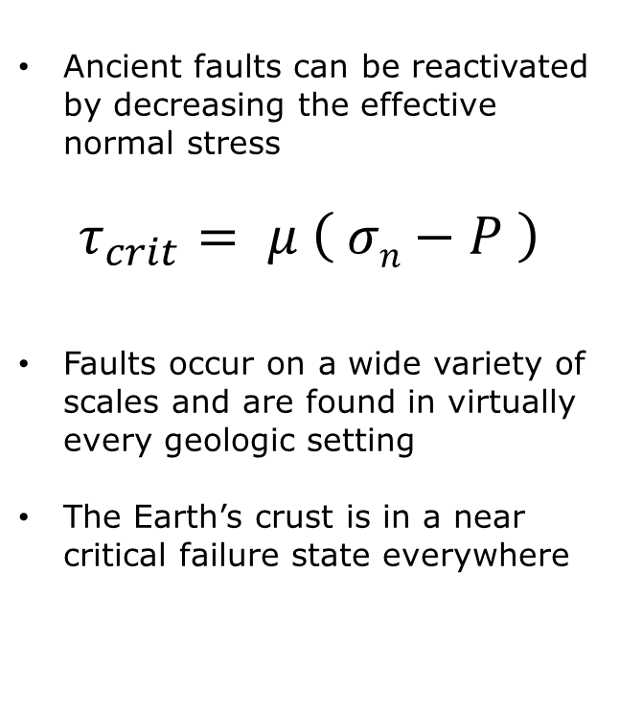
Mechanics of Induced Earthquakes
Pore Pressure Effect
Ancient faults can be reactivated by decreasing the effective normal stress
$$τ_{crit}= μ \left( σn−P \right)$$
Faults occur on a wide variety of scales and are found in virtually every geologic setting
The Earth’s crust is in a near critical failure state everywhere

Slide 19
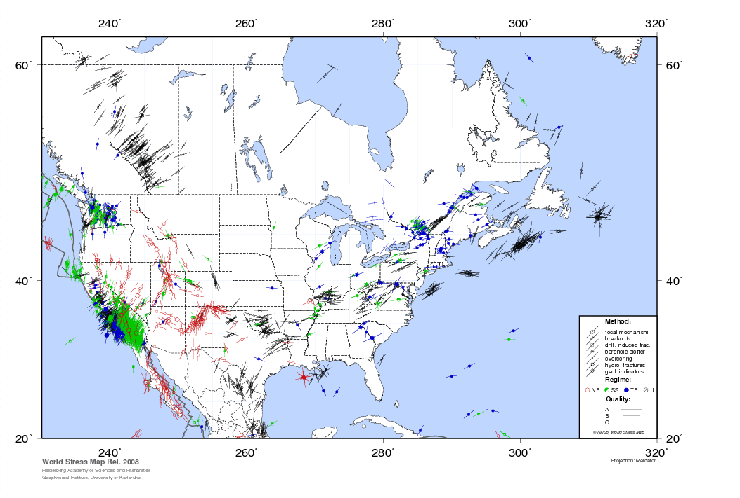
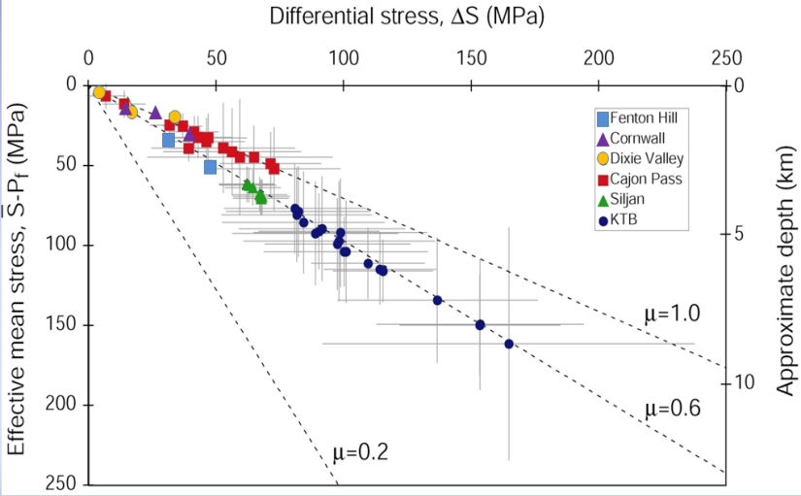
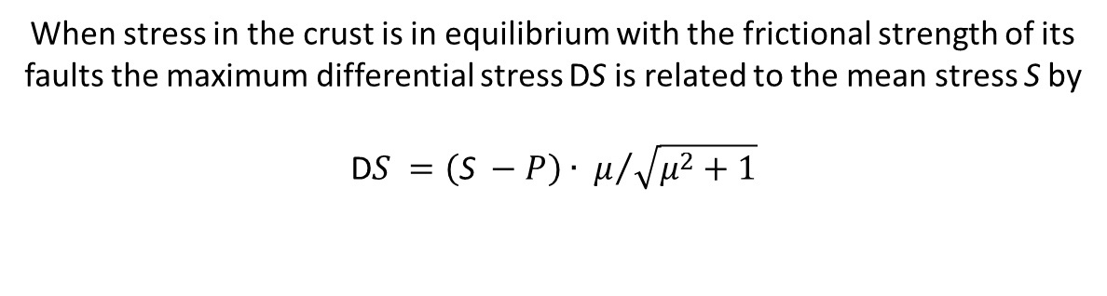
Critically Stressed Crust
Townend and Zoback, 2001
When stress in the crust is in equilibrium with the frictional strength of its faults the maximum differential stress DS is related to the mean stress S by
$$\text{D}S =\left(\text{S} −P\right)∙ μ/{\sqrt{μ^{2}+1}}$$
_
_

Slide 20
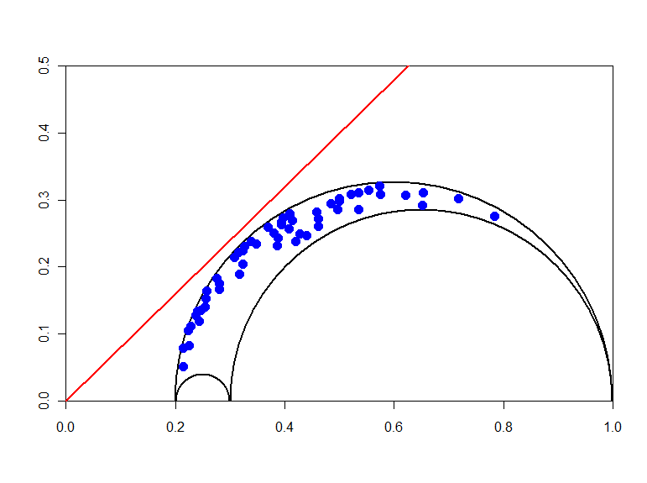




Hydraulically Conductive Faults in a Near-Critical Stress State
$$μ=0.8$$
$$τ/S_{v}$$
$${( σ}_{n}− P_{p} )/ S_{v}$$

Slide 21
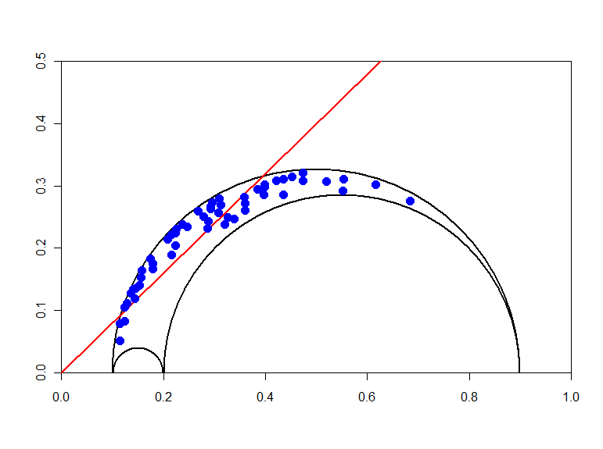

Increasing the Pore Fluid Pressure May Cause Well-Oriented Faults to Fail
$$μ=0.8$$
$$τ/S_{v}$$
hydroshear regime
$$∆P$$
$${( σ}_{n}− P_{p} )/ S_{v}$$

Slide 22
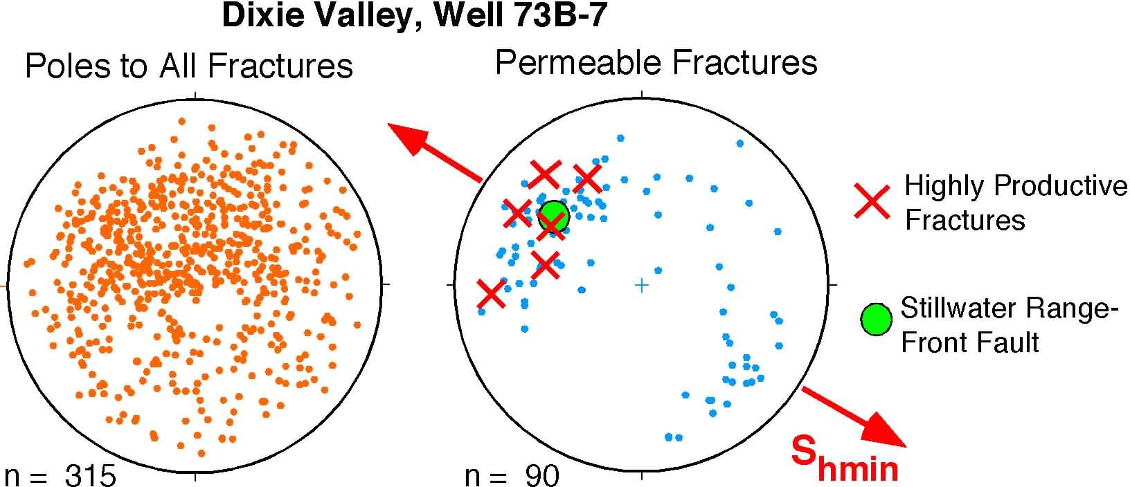
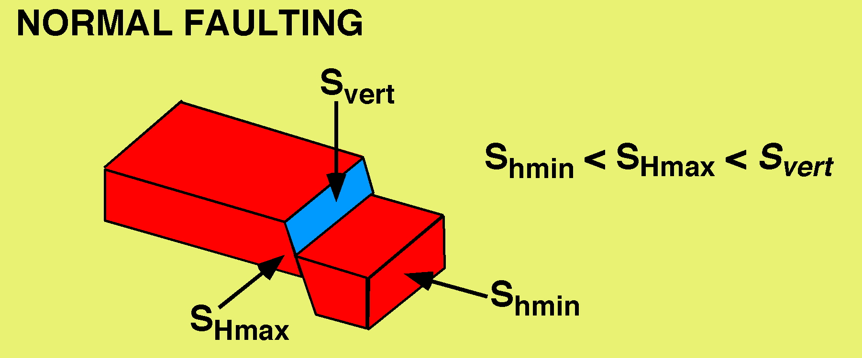
Hydraulically Conductive Fractures and Faults
Depth: 1850-2640 m
lower hemisphere
stereographic projections

Slide 23
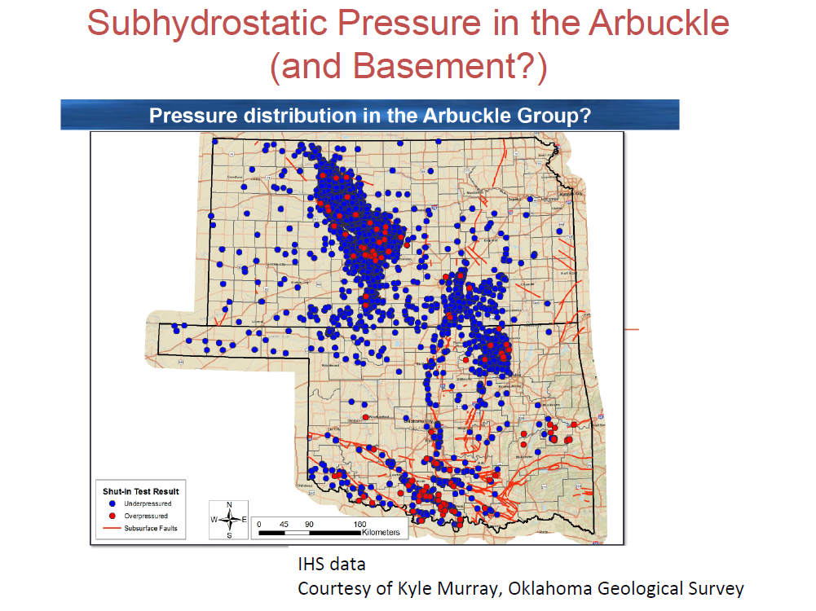

Slide 24
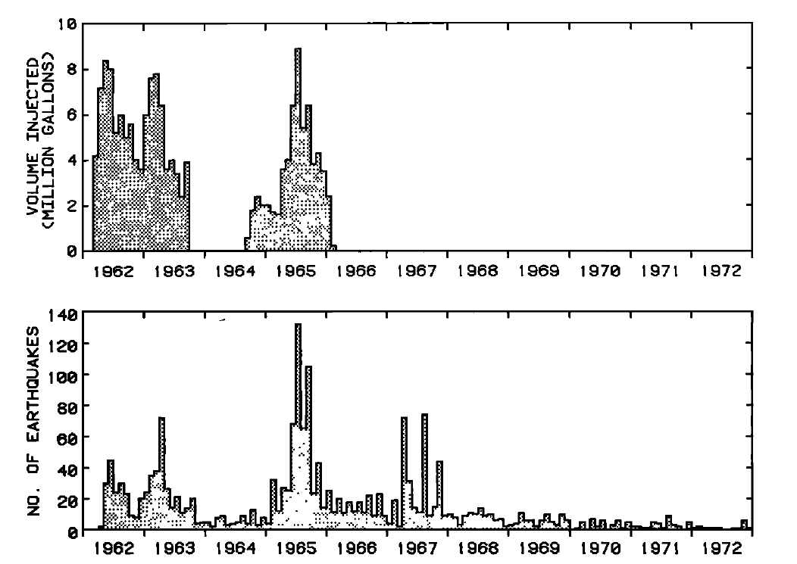
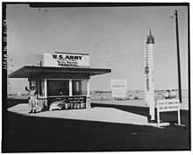
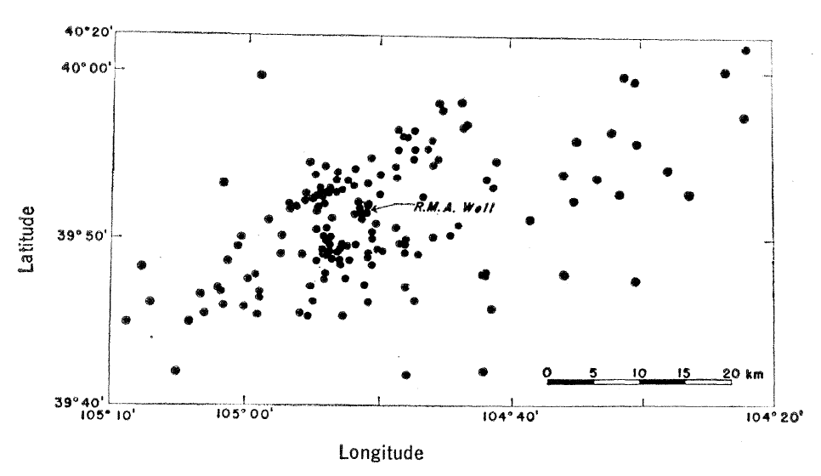
Rocky Mountain Arsenal, Colorado
Earthquake locations by Y. Wang (1965) that led to the discovery of earthquakes induced by wastewater injection at the Rocky Mountain Arsenal. Locations based on regional seismic stations.

Slide 25
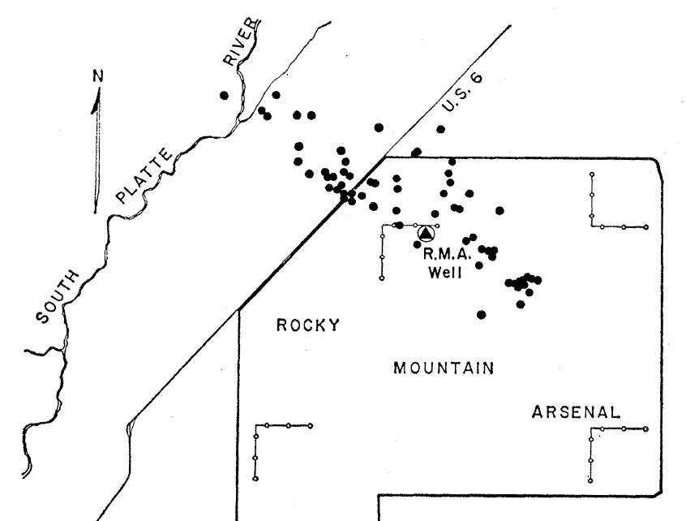
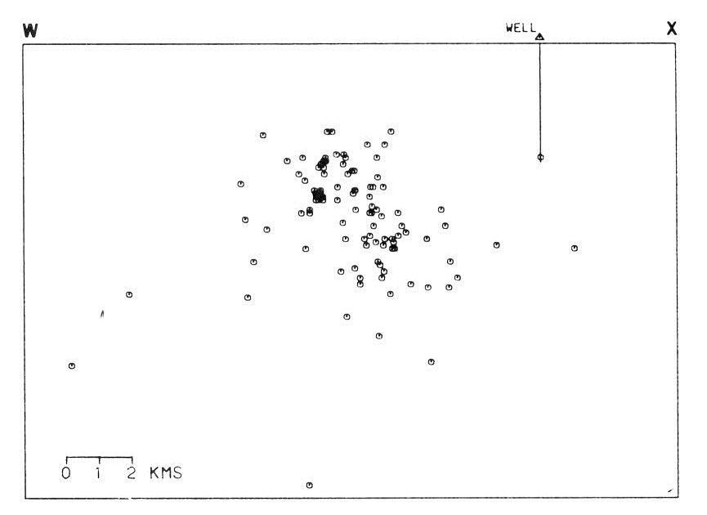

Rocky Mountain Arsenal, Colorado
1966
5 km radius
1967
Diffuse locations of seismicity proved to be an artifact. Well-located events define a vertical fault in Precambrian basement.

Slide 26
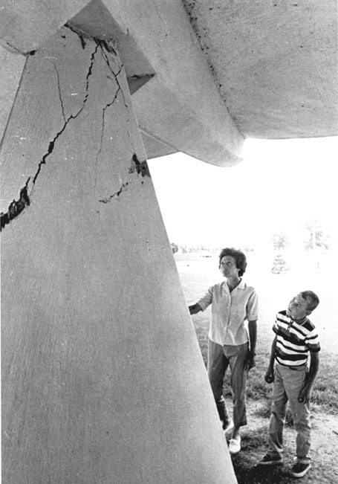
Rocky Mountain Arsenal, Colorado
“The disposal of waste fluids by injection into a deep well has triggered earthquakes near Denver, Colorado.”
Healy, J.H., Rubey, W.W., Griggs, D.T. and Raleigh, C.B., 1968,
The Denver Earthquakes; Science, v. 161, p. 1301-1310.
Injection Volume
Earthquake Count
M_{w} 4.8
Key Points:
High-volume injection into basement
Release of long-stored tectonic stress on ancient faults
Earthquakes occurred more than 10 km from injection point
Largest earthquakes occurred over one year after injection stopped
Earthquakes continued into the 1980s

Slide 27
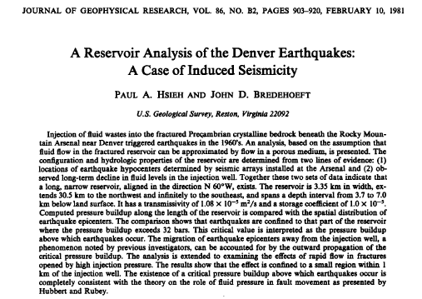
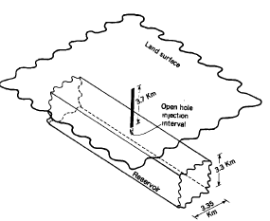
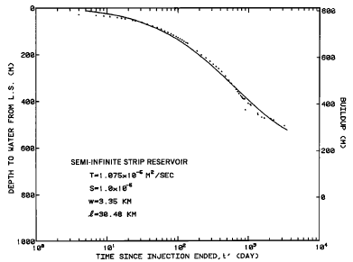
Rocky Mountain Arsenal, Colorado
“The existence of a critical pressure buildup above which earthquakes occur is completely consistent with the theory on the role of fluid pressure in fault movement as presented by Hubbert and Rubey.”

Slide 28
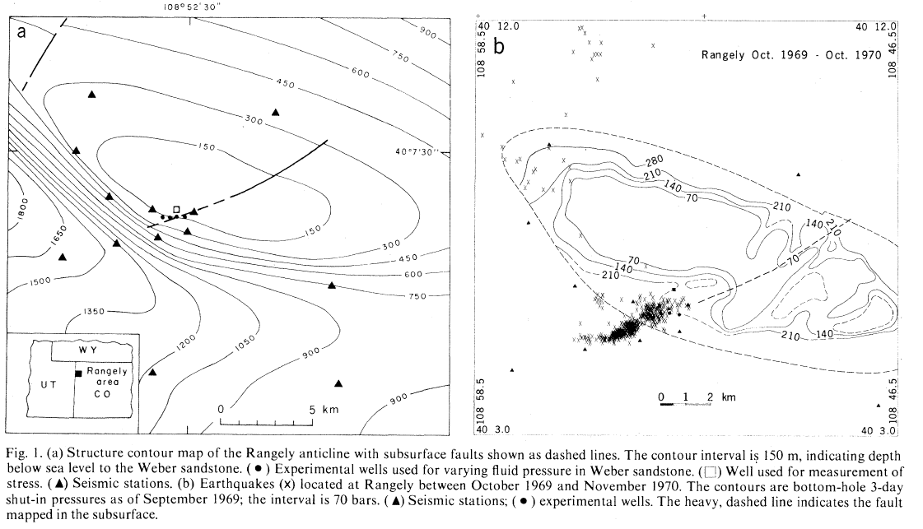
A Test of the Effective Stress Hypothesis at Rangely, Colorado
Raleigh, C.B., Healy, J.H. and Bredehoeft, J.T, 1976, An Experiment in Earthquake Control at Rangely, Colorado; Science, v. 191, p. 1230-1237.

Slide 29
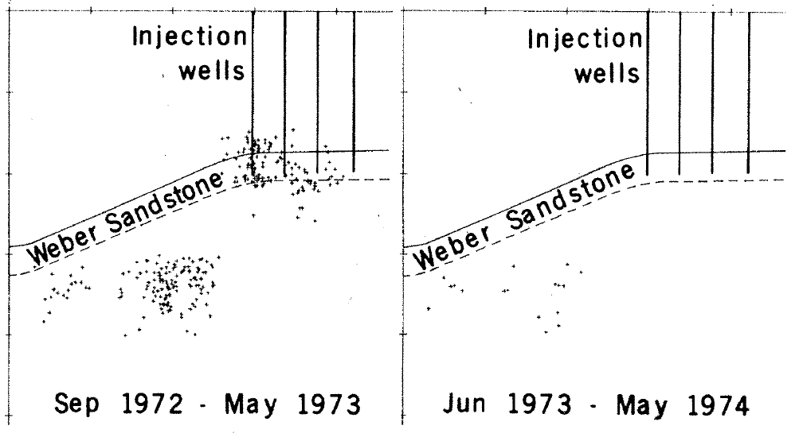
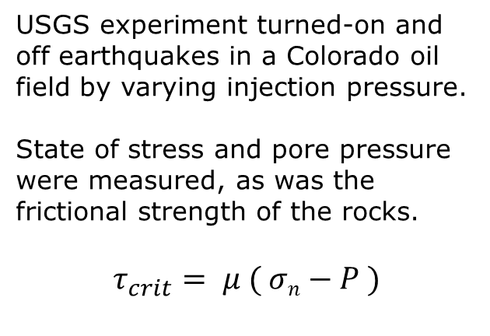
A Test of the Effective Stress Hypothesis at Rangely, Colorado
Injection
Backflow
USGS experiment turned-on and off earthquakes in a Colorado oil field by varying injection pressure.
State of stress and pore pressure were measured, as was the frictional strength of the rocks.
$$τ_{crit}= μ ( σn−P )$$
2
Depth (Km)
4
“The cessation of seismic activity within 1 day of the initiation of backflow in the experimental wells in May 1973 established the correlation between fluid pressure and earthquakes beyond a reasonable doubt.”
Raleigh, C.B., Healy, J.H. and Bredehoeft, J.T, 1976, An Experiment in Earthquake Control at Rangely, Colorado; Science, v. 191, p. 1230-1237.

Slide 30
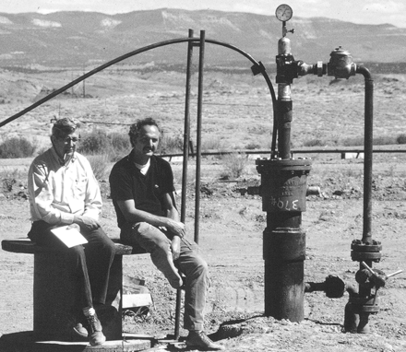
A Test of the Effective Stress Hypothesis at Rangely, Colorado
Injection
Backflow
2
Depth (Km)
4
“Permeability to fluid flow along the fault is sufficiently large that adjustment of fluid pressure in the fault follows rapidly upon changes in fluid pressure at the experimental wells.”
Raleigh, C.B., Healy, J.H. and Bredehoeft, J.T, 1976, An Experiment in Earthquake Control at Rangely, Colorado; Science, v. 191, p. 1230-1237.

Slide 31
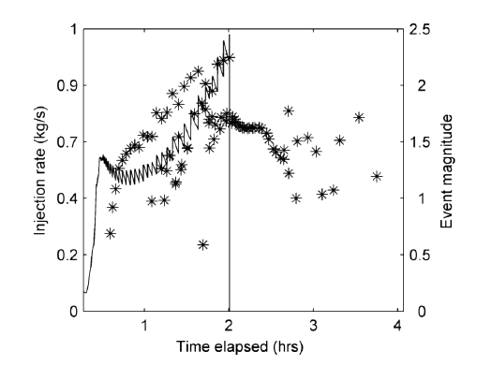
What other processes or initial conditions are important?
Fault slip-enhanced permeability
Rate-and-state nucleation
Spatial heterogeneity in the state of stress
Thermal stresses (cold fluid into hot rock)
Recency of faulting
Chemical processes and fluid-rock interaction
…
McClure and Horne, 2011, Investigation of injection-induced seismicity using a coupled fluid flow and rate/state friction model, Geophysics, doi:10.1190/GEO2011-0064.1

Slide 32
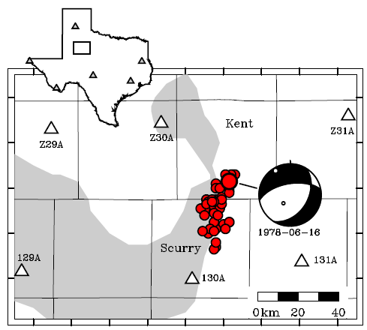
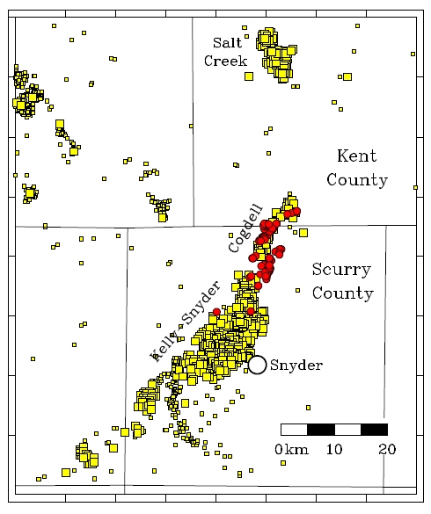
Under nominally similar conditions why are earthquakes induced in one place but not another?
Gan and Frohlich, 2013, Gas injection may have triggered earthquakes in the Cogdell oil field, Texas, PNAS, doi/10.1073/pnas.1311316110

Slide 33
Case Study #1: Paradox Valley, Colorado

Slide 34
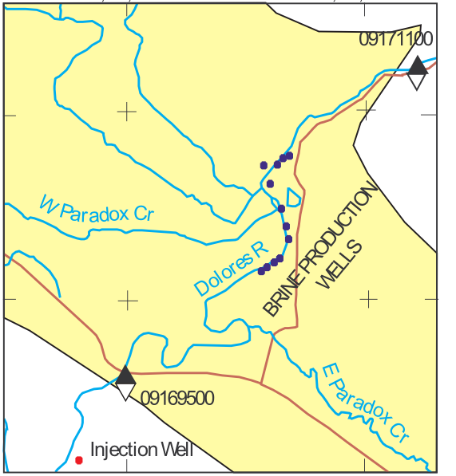

U. S. Bureau of Reclamation Paradox Valley Project
Saltwater brine extracted from shallow water table below Dolores river is re-injected into limestone at 4.5 km depth
Purpose: Keep salt out of the Colorado River
River
Salt
2CaCO_{3(s)} + Mg⁺⁺ + SO₄⁻⁻
CaMg(CO₃)_{2(s)} + CaSO_{4(s)}
Magnesium in the brine dolomitizes the limestone and precipitates anhydrite
Kharaka, Y. K., et al., 1997, Water Resources Research, v. 33, 1013-1020.
Block, L., et al., 2014, The 24 January 2013 M_{L} 4.4 Earthquake Near Paradox, Colorado and Its Relation to Deep Well Injection, Seismological Res. Lett., v. 85, 609-624.
Notes:
http://upload.wikimedia.org/wikipedia/commons/f/f3/Paradox_Valley_Unit_Map.png

Slide 35

Work of the U. S. Bureau of Reclamation Paradox Valley Unit
Injection Well
Pumping History and Seismicity
Ake, J., et al., 2005, Deep-Injection and Closely Monitored Induced Seismicity at Paradox Valley, Colorado. Bull. Seismological Soc. Am, v. 95, 664-683.
Block, L., et al., 2014, The 24 January 2013 M_{L} 4.4 Earthquake Near Paradox, Colorado and Its Relation to Deep Well Injection, Seismological Res. Lett., v. 85, 609-624.
Notes:
Re-drafted Ake et al figure and added the stresses and pressures.
They found that when the injection pressure corrected to 4.3 km depth reached ~80MPa, seismicity began
Only one group of earthquakes fairly close to the well “turned on and off” with the injection pressure.

Slide 36
State of Stress and Earthquakes at Paradox Valley, CO
Stresses measured at injection depth of 4.3 km (from minifracs and density log)
Pre-injection fluid pressure
(P = 43.6 MPa)
µ = 0.83
P = 81.4 MPa
S_{hmin}
S_{v} (≤ σ₁)
ΔP = 17 Mpa
(P = 61 MPa)
Effective Normal Stress, MPa
Most earthquakes then occurred during large-volume injection associated with primary brine disposal (avg. P = 81.4 MPa > S_{hmin})
First MEQs when borehole fluid pressure at 4.3 km reached 64 to 68 MPa during Injection Test #1 (11,000 m³ in 13 days), close to predicted threshold of P = 61 MPa.
Ake, J., et al., 2005, Deep-Injection and Closely Monitored Induced Seismicity at Paradox Valley, Colorado. Bull. Seismo. Soc. Am, v. 95, 664-683.
Notes:
Re-drafted Ake et al figure and added the stresses and pressures.
They found that when the injection pressure corrected to 4.3 km depth reached ~80MPa, seismicity began
Only one group of earthquakes fairly close to the well “turned on and off” with the injection pressure.

Slide 37
Case Study #2: Azle Texas
2

Slide 38

Azle Texas earthquakes of November 2013 – January 2014

Slide 39

Routine USGS/NEIC Locations
20 Km

Slide 40


Temporary Network Locations
Earthquakes hypocenters define a northwest dipping normal fault in the shallow basement (3.5 to 7 km)

Slide 41

Faults, Seismicity and Wells

Slide 42

Earthquake Swarm of January 28, 2014
Double-difference waveform cross correlation locations
Courtesy of David Shelly

Slide 43
Why Earthquakes Near Azle?
Natural earthquake activity?
Water level changes in Eagle Mountain Lake?
Water table decline due to prolonged drought?
Production from the Barnett Shale?
Waste water disposal?

Slide 44



Could Lake Level Changes Have Induced the Earthquakes?
Compute stress change at depth using the Boussinesq solution for a surface load. Maximum change in focal region < 1 KPa.

Slide 45

Barnett Shale Production?

Slide 46
Wastewater Disposal?
High-volume wastewater disposal wells

Slide 47



Modeling the Effects of Injection and Production
Solve the groundwater-flow equation for pressure assuming single phase flow and nearly flat-lying sedimentary layers, where
$$\frac{dP}{dt}= −\frac{1}{S}∇∙\left(−K ∇P\right)−G$$
where S is the specific storage and $K$ is the hydraulic conductivity and G is the source term.
Causal Factors for Seismicity near Azle, Texas
Matthew J. Hornbach, Heather R. DeShon, William L. Ellsworth, Brian Stump, Chris Hayward, Harrison R.Oldham, Cliff Frohlich, Jon E. Olson, M. Beatrice Magnani, Casey Brokaw, James H. Luetgert.
Nature Communications, in review.

Slide 48

Causal Factors for Seismicity near Azle, Texas
Matthew J. Hornbach, Heather R. DeShon, William L. Ellsworth, Brian Stump, Chris Hayward, Harrison R.Oldham, Cliff Frohlich, Jon E. Olson, M. Beatrice Magnani, Casey Brokaw, James H. Luetgert.
Nature Communications, in review.

Slide 49
Evidence For or Against Proposed Mechanisms
Potential Cause | Arguments For | Arguments Against
Natural | Rare earthquakes do occur in Texas and history is short | Earthquakes in this region unknown for >100 years
Lake Level Change | Falling lake level reduces load on footwall | Stress changes from falling lake level are too small(< 1 KPa)
Production | Poroelastic stress changes would encourage normal faults to failure | Poroelastic stress changes are smaller than production pressure decrease
Injection | Pressure increase at fault in range seen for natural triggering | Unclear how pressure is transmitted into basement

Slide 50
Case Study #3: Oklahoma

Slide 51


Slide 52


Earthquakes in north-central Oklahoma (and southern Kansas) initiate within about a year of drilling to develop shale oil resources
SandRidge Energy

Slide 53


Fracking or Wastewater Disposal?
Hundreds of thousands of frac jobs in the U.S.
Only a handful of felt events.
None as large as magnitude 3 have been documented in the U.S.
M_{w} 4.2 in Canada
30,000 deep wastewater wells in U.S.
Many with volumes > 10⁶ m³
Few with detected seismicity
Magnitudes as large as M_{w} 5.7
Notes:
Hydraulic fracturing is used to increase the permeability of shales or coal seams so as to produce natural gas. These wells also produce formation brines and fracking compounds that are usually disposed by injection down deep wells.

Slide 54


1970 - 1979
P(one or more) = 1 – exp(-(Annual Rate) t)

Slide 55


1980 - 1989

Slide 56


1990 - 1999

Slide 57


2000 - 2008

Slide 58



2009 - 2013
New Ways of Extracting Oil from Previously Unproductive Formations

Slide 59

Example of the Hunton Dewatering Play
Water to oil ratio at start:
1:50
When economical:
15:1

Slide 60



Central Oklahoma “Jones” Swarm
2009-2011
Oklahoma City Injection
Injection Wells
(area ~ annual volume)
million m³
Year
25 Km
Sharp increase in central Oklahoma seismicity 2009-2014 induced by massive wastewater injection. K. M. Keranen, M. Weingarten, G.A. Abers, B. A. Bekins, S. Ge
Science, 2014.

Slide 61

2009 - 2013
2011M_{w} 5.7 Prague, OK
Wells
Keranen, K.M., Savage, H.M., Abers, J.A., and Cochran, E.S., 2013, Potentially induced earthquakes in Oklahoma, USA: Links between wastewater injection and the 2011 Mw 5.7 earthquake sequence, Geology., doi:10.1130/G34045.1

Slide 62


2014 through May
P(M≥5½) = 0.23 to 0.53
in the next 12 months
Compared with the 1970-2008 expectation of
P(M≥5½) = 0.003

Slide 63


Oklahoma Seismicity 1973 - 2014
Oklahoma and California Earthquake Rate for Sequences with at least one M ≥ 3
California
Oklahoma

Slide 64




Five Candidate Logic Tree Branches
Branch 0: No change in underlying Long-Term Background EQ Rate
Model used in the 2014 update to hazard map
(2% in 50 years)
Branch 1: Short-Term Variability in a Long-Term Background EQ Rate
Earthquake rate is not stationary and so Poisson model is hard to justify
Branch 2: Seismicity Rate Change is the “New Normal”
Extrapolation of current rate for 50 years in question
Uncertain how to justify choice of new maximum magnitude (Mmax)
Branch 3: New EQs Come From a New, Distinct EQ Population
Mmax
Model assumes knowledge of end of activity and decay rate
Branch 4: Increase is transient

Slide 65

Base Case: Ignore Increased Earthquake Rate
Branch 3: New EQs Come From
a New, Distinct EQ Population
Content is preliminary and should not be considered a final USGS product.

Slide 66
1 Hz, 02px50
 | No SFI base-case | SFI Mmax=6 | Ratio Mmax6/bc | SFI Mmax=7 | Ratio Mmax7/bc
Wichita | 0.024 | 0.033 | 1.4 | 0.055 | 2.3
Austin | 0.013 | 0.019 | 1.5 | 0.027 | 2.1
Oklahoma City | 0.044 | 0.226 | 5.1 | 0.406 | 9.2
1 Hz hazard (2% in 50 yrs) from seismicity only (2008 GMPEs)
Branch 3: New EQs Come From
a New, Distinct EQ Population
Content is preliminary and should not be considered a final USGS product.

Slide 67

Think Locally, Act Globally
2011 Prague, Oklahoma Earthquake
M_{w} 5.7
No fatalities; a few injuries; moderate economic damage

Slide 68



Think Locally, Act Globally
2011 Prague, Oklahoma Earthquake
M_{w} 5.7
No fatalities; a few injuries; moderate economic damage
1986 San Salvador Earthquake
M_{w} 5.7
1500 fatalities; 10,000 injuries;
100,000 homeless

Slide 69

Think Locally, Act Globally

Slide 70
Where do we go from here?
We currently have very limited predictive capability due to:
  Uncertainty in the stress state and pore pressure
  Rudimentary knowledge of flow paths
  Poor knowledge of potentially capable faults
  Poor detection and location capabilities of seismic networks
  Difficulty in predicting how large an earthquake will grow once initiated
  Uncertainty in the expected strength of shaking
  Uncertainty in the physical model(s) used to describe the system

Slide 71
Thank you

Slide 72
“Magnitude Range” of Earthquakes Induced
by Different Anthropogenic Sources
Magnitude

Slide 73

How well does the 2008 map forecast 2009-2012 seismicity?
How many earthquakes were expected to occur in 2009 – 2012?
How many earthquakes did occur?
How likely was it that the differences were by chance?

Slide 74

Smoothed Seismicity “NSHM08 a-values”
Induced earthquakes removed in polygons

Slide 75

Declustered Earthquakes 2009-2013

Slide 76

P(N_{obs}|NSHM): 2009-2013
Content is preliminary and should not be considered a final USGS product.
Notes:
Cogdell (p~0.01)

Slide 77
July 2014 Update to the U. S. National Seismic Hazard Map
How should we account for the increased seismicity?

